Slide 1
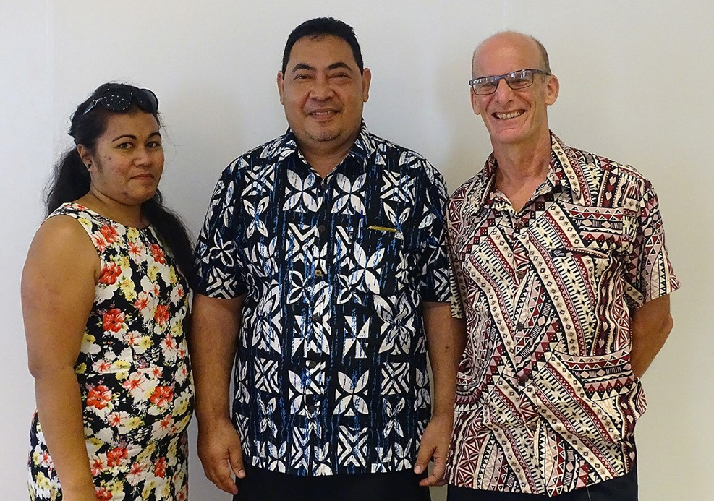
2016 Tokelau Census
Module 5 Tokelau National Statistics Office

Slide 2
What we will cover
Current operating environment
What are our aims?
How are we getting there?
Outputs we delivered
Outputs we seek to deliver
Working across government
Summary

Slide 3
Current operating environment
2.3 full-time staff equivalents
Statistics Rules (2013) = statistics legislation
Disjunct systems of information management
Lots of data being generated in departments
No easy way to bring this together - yet

Slide 4
What are our aims?
Strengthen our institution, and the role of the statistics office across government
Provide statistical leadership
Build statistical capacity, understanding and use across government
Be a model government agency (eg annual SOI = Statement of Intent for each Financial Year)

Slide 5
How are we getting there?
Statistics Rules (2013) = solid legal framework supported by General Fono, on:
The role of the National Statistician
The role of the office (TNSO)
Respondent compliance
Privacy and security
Work with other departments’ datasets

Slide 7
How are we getting there? (cont’d)
Adopt, harmonize, and use
International best practice:
UN fundamental principles on official statistics
To ensure a robust office, making transparent releases, and being accountable for its decisions
Generic business process model
To ensure we follow due process in development, collection and output of statistics
To ensure fit-for-purpose data

Slide 8
How are we getting there? (cont’d)
We can’t do it all on our own
Build our regional and international partnerships
Statistics New Zealand (StatsNZ)
(Secretariat of) the Pacific Community (SPC)
Other regional statistics offices
National Strategy for the Development of Statistics (NSDS) with Paris21 organisation

Slide 9
Aim:
TNSO as a central repository of Tokelau Official Statistics, assisting all government departments with data collection, analysis, interpretation, long-term curation and distribution as needed.
Already completed: Assessment of Tokelau’s National Statistics System; and Roadmap for NSDS.
Next step:
Develop NSDS proper with full team (PARIS21 funding requested)

Slide 10
Outputs we delivered
2016-2017 financial year
2016 Tokelau Census, with publications completed
Quarterly Consumer Price Index (since June 2012), soon updated with new basket of goods and services
Household Income and Expenditure Survey (HIES) results to be made public in English and Tokelauan
2014 Imports study completed
Gross National Product (GDP) calculated for first time this century

Slide 11
Consumer Price Index
An objective measure of the changing cost over time of goods and services purchased in Tokelau
Tokelau’s official measure of inflation - ONGOING
Can show effect of policies e.g. Health & “sin tax”

Slide 12
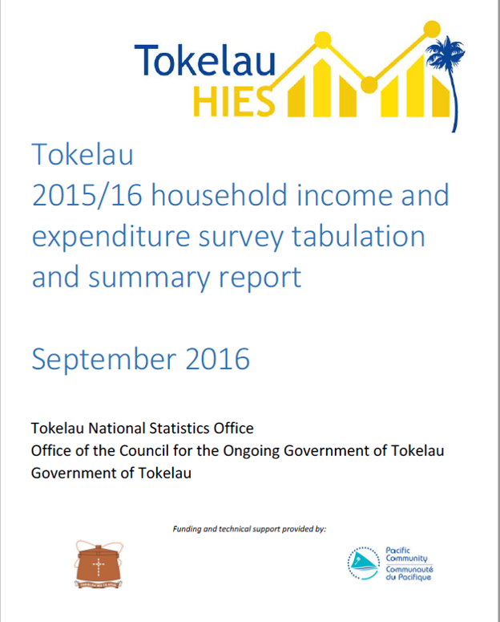

Slide 13
Outputs we seek to deliver
2017 and beyond
Gross National Product (GDP) publication and updates
Goods: International Merchandise Trade Statistics (IMTS) from 2014 onwards
Prepare for next HIES 2019/20?
Pre-election population Count December 2019
Next Census October 2021

Slide 14
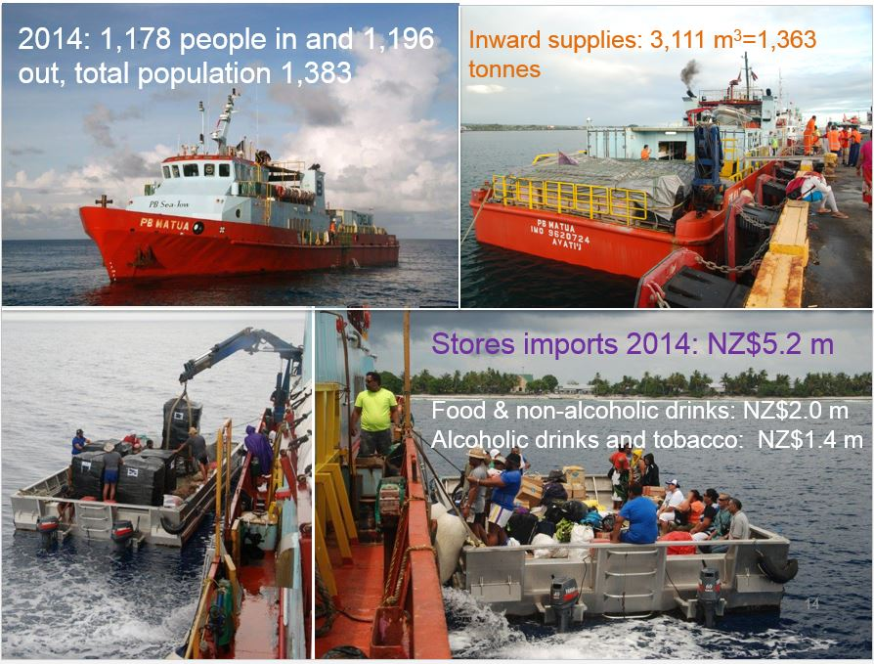
Notes:
Quality of life is not just about the policies the government puts into place. It is also about lifestyle and health choices made by individuals. Unfortunately, from an objective statistical perspective, the choices are almost all bad when it comes to eating, drinking, smoking, and producing solid waste. I’m presenting these data to you in the hope that we can improve the situation.

Slide 15
Working across government
Many collections require active relationships with other departments, and villages
Vital statistics
Department of Health; Department of Transport and Support Services (Civil Registration = Births, Deaths and Marriages)
Migration and Custom statistics
Department of Transport and Support Services
Quarantine statistics
Department of EDNRE
Other needs?

Slide 16
Working across government (cont’d)
Department of Education: Student and teacher data; Sustainable Development Goals (SDGs)
Supporting the Planning and Monitoring Unit
Monitoring and reporting framework with NZ Aid / Ministry of Foreign Affairs
Changing public servants’ behaviour towards data
Helping develop administrative collections for monitoring and planning
Information technology: file & data sharing

Slide 17
In summary
An ambitious programme, with few resources
Need to be innovative and coordinated
Make the most of our opportunities
Prioritise! Prioritise! Prioritise!
Keen to support and co-operate!

Slide 18
Getting in touch
Kele Lui – National Statistician
+685 777 4941
kele.lui@tokelau.org.nz
dr Jaap (“iapi”) Jasperse – Statistics Advisor
+685 729 4913
iapi.jasperse@tokelau.org.nz
Mafa Mativa – Statistics Officer
+685 774 1778
mafa.mativa@tokelau.org.nz

