Slide 1
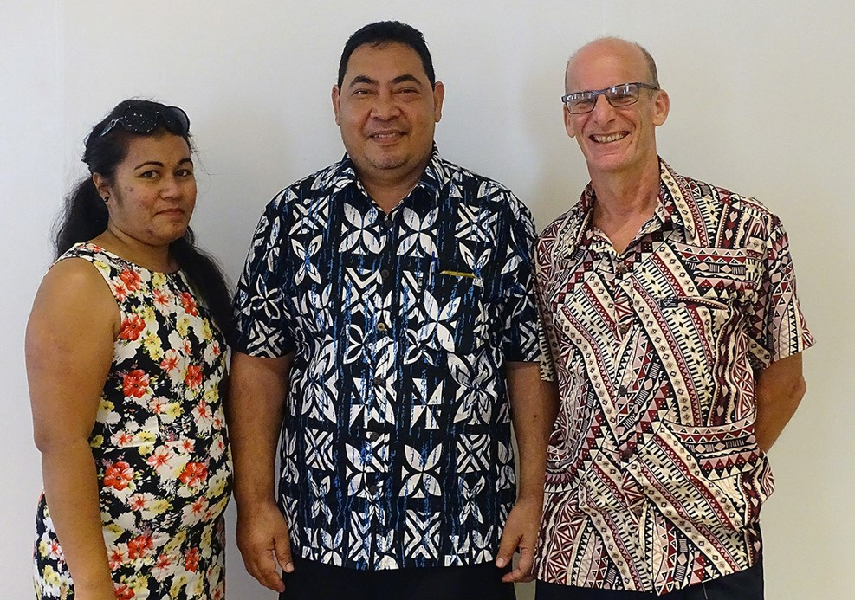
Tuhiga igoa Tokelau 2016
Vaega 5 Ofiha o Fuainumela Fakamaumau a Tokelau
Notes:
Slide:
2016 Tokelau Census
Module 5 Tokelau National Statistics Office

Slide 2
Na vaega e talanoa agai ki ei
Na tulaga e galue ai nei
Na fakamoemoega ma na tini e taumafai ki ei?
E vefea o na taunuku ki ei?
Na vaega na auhia e kimatou na fakatino ma tuku atu
Na vaega ka taumafai kimatou ke fakatino
Galulue fakatahi ma ietahi mataeke o te malo
Kotokotoga
Notes:
Slide:
What we will cover
Current operating environment
What are our aims?
How are we getting there?
Outputs we delivered
Outputs we seek to deliver
Working across government
Summary

Slide 3
Na tulaga e galue ai nei
2.3 te kaufaigaluega
Tulafono o Fuainumela fakamaumau 2013
He katoatoa lelei na hihitemi mo te puipuiga o na fakamatalaga
E lahi na fakamaumauga e maua ina tahi mataeke
Ko heki iei he auala faigofie ke tuku fakatahi ai ienei vaega
Notes:
Slide:
Current operating environment
2.3 full-time staff equivalents
Statistics Rules (2013) = statistics legislation
Disjunct systems of information management
Lots of data being generated in departments
No easy way to bring this together - yet

Slide 4
O matou fakamoemoega?
Fakamalohia te ofiha, ma fakamatea te tulaga o te ofiha o fuainumela fakamaumau ki ietahi vaega/kaufaigaluega a te malo
Tuku atu ni takitakiga i na matakupu agai kina fuainumela fakamaumau
Atiake te mafai,iloa ma te fakaaogagia o na fuianumela fakamaumau i na tahi vaega/kaufaigaluega a te malo
Kavea ma ata fakatakitaki o te malo(eg annual SOI = Statement of Intent for each Financial Year)
Notes:
Fakamakeke te matou ofiha, te kaufaigaluega
Slide:
What are our aims?
Strengthen our institution, and the role of the statistics office across government
Provide statistical leadership
Build statistical capacity, understanding and use across government
Be a model government agency (eg annual SOI = Statement of Intent for each Financial Year)

Slide 5
E vefea ona pa kimatou ki ei?
Tulafono fuainumela fakamaumau = he fakavae malohi na hapotu mai ki ei te Fono fakamua,kite:
Galuega/tulaga a te tino fakauluulu o Fuainumela fakamaumau
Galuega/tulaga o te ofiha(TNSO)
Tauhi tonu o kilatou e tuku mai na fakamatalaga
Malu puipuia ma te haogalemu
Galulue ma ietahi fakamaumauga a ietahi mataeke
Notes:
Slide:
How are we getting there?
Statistics Rules (2013) = solid legal framework supported by General Fono, on:
The role of the National Statistician
The role of the office (TNSO)
Respondent compliance
Privacy and security
Work with other departments’ datasets

Slide 7
E vefea ona pa kimatou ki ei? (fakaauau)
Puke, fakatulaga tonu ma fakaaoga
Fakatinoga pito hili lelei fakavaomalo:
Maliliega fakavae mo na fakamaumauga aloakia a te Malo Kaufakatahi
Ke fakamautinoa he ofiha malohi, fakatino ni fakalauiloga hako, ma mafai ke tau tali atu ki a na tonu na fai
Ata lautele mo na fekuikuifakiga I te fakatinoga o ana galuega
Ke fakamautinoa e olo gatahi ki na fekuikuifakiga i te tapenaga, fakamaopoopoga o na fakamatalaga maua
Ke famautinoa ko na fakamatalaga e fetaui lelei ma te pogai
Notes:
Slide:
How are we getting there? (cont’d)
Adopt, harmonize, and use
International best practice:
UN fundamental principles on official statistics
To ensure a robust office, making transparent releases, and being accountable for its decisions
Generic business process model
To ensure we follow due process in development, collection and output of statistics
To ensure fit-for-purpose data

Slide 8
E vefea ona pa kimatou ki ei? (fakaauau)
E he mafai ke fakatino uma e kimatou
Atiake a na faiga paaga ite Pahefika ma fafo atu faka va o malo
Statistics New Zealand (StatsNZ)
(Secretariat of) the Pacific Community (SPC)
Other regional statistics offices
National Strategy for the Development of Statistics (NSDS) with Paris21 organisation
Notes:
Slide:
How are we getting there? (cont’d)
We can’t do it all on our own
Build our regional and international partnerships
Statistics New Zealand (StatsNZ)
(Secretariat of) the Pacific Community (SPC)
Other regional statistics offices
National Strategy for the Development of Statistics (NSDS) with Paris21 organisation

Slide 9
Tini:
Ko te Ofiha o Fuainumela fakamaumau o Tokelau he vaega taua lahi lele, e lagolago ki ietahi mataeke o te malo kite fakamaopoopoga ona fakamaumauga, taumafai ke fakamatala ienei fakamaumauga fuainumela, fakaliliu, ma taumafai ke fakailoa atili ma tufatufa kafai e manakomia
Kua maea: Matauga o te Hihitemi o Fuainumea fakamaumau o Tokelau; ma te fakatatiaga o na auala mo te NSDS.
Te lakahaga e hohoko mai: Fakatupu te NSDS ma te kaufaigaluega katoa (fakatagi ki he fehoahoniga mai te PARIS21)

Slide 10
Na vaega na auhia e kimatou
Tala tupe ote tauhaga 2016-2017
Tuhiga igoa a Tokelau 2016, kua maea ma totoka
Numela tuku fakatahi ote tau ona koloa ma na tautuaga e fua taki kuata ite tauhaga(kamata mai ia Iuni 2012), na toe iloiloa na koloa ma na tautuaga e aofia i tenei galuega
Ko na ikuga o te Hakilikiliga mo na tupe maua ma na tupe fakafano kua tali fakahalalu atu ite gagana Igilihi ma te Faka Tokelau
Na koloa kavatu ki Tokelau 2014 kua totoka
Ko te numela e fakailoa ai te tuputupu pea o te tamaokaiga o Tokelau na fakatino mo te taimi muamua ite henetuli nei
Notes:
Slide:
Outputs we delivered
2016-2017 financial year
2016 Tokelau Census, with publications completed
Quarterly Consumer Price Index (since June 2012), soon updated with new basket of goods and services
Household Income and Expenditure Survey (HIES) results to be made public in English and Tokelauan
2014 Imports study completed
Gross National Product (GDP) calculated for first time this century

Slide 11
Tau o na koloa ma na tautuaga e fakatau e tagata
Ko te kautu ke fua na huiga agai kina tau ona koloa ma na tautuaga e fakatau e tagata i Tokelau
Fua alokia ia kite hikitaga a Tokelau- ONGOING
E kitea ai te aoga ona taki/polihi f.t. ola malolo & “lafog”
Notes:
Slide:
Consumer Price Index
An objective measure of the changing cost over time of goods and services purchased in Tokelau
Tokelau’s official measure of inflation - ONGOING
Can show effect of policies e.g. Health & “sin tax”

Slide 12
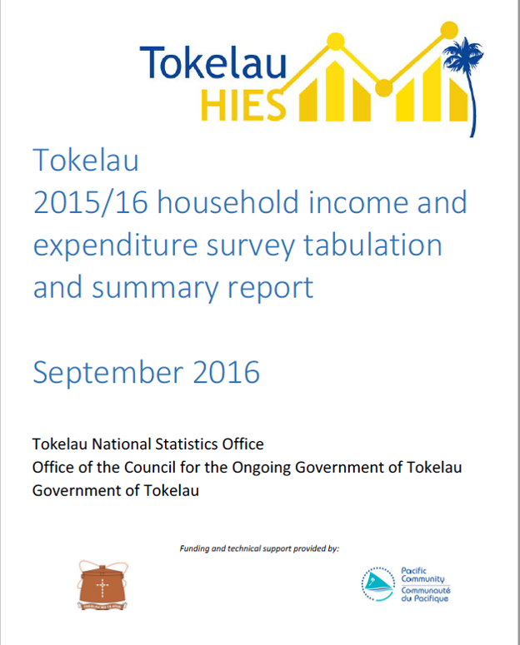

Slide 13
Na vaega e kikila kimatou ke fakatino
2017 ma te agai ki mua
Kikilaga ki te fakatinoga fou o te numela e fua ai te tuputupu ote tamaokaiga
Koloa: Numela fakamaumau agai kina koloa faka va o malo (IMTS) mai te 2014
Haoni mo te Hakilikiliga o na tupe maua ma na tupe fakafano ite 2019/2020?
Faitauga o te aofaki o tagata mo te faiga palota ia Tehema 2019
Tuhiga igoa ia Oketopa 2021
Notes:
Slide:
Outputs we seek to deliver
2017 and beyond
Gross National Product (GDP) publication and updates
Goods: International Merchandise Trade Statistics (IMTS) from 2014 onwards
Prepare for next HIES 2019/20?
Pre-election population Count December 2019
Next Census October 2021

Slide 14
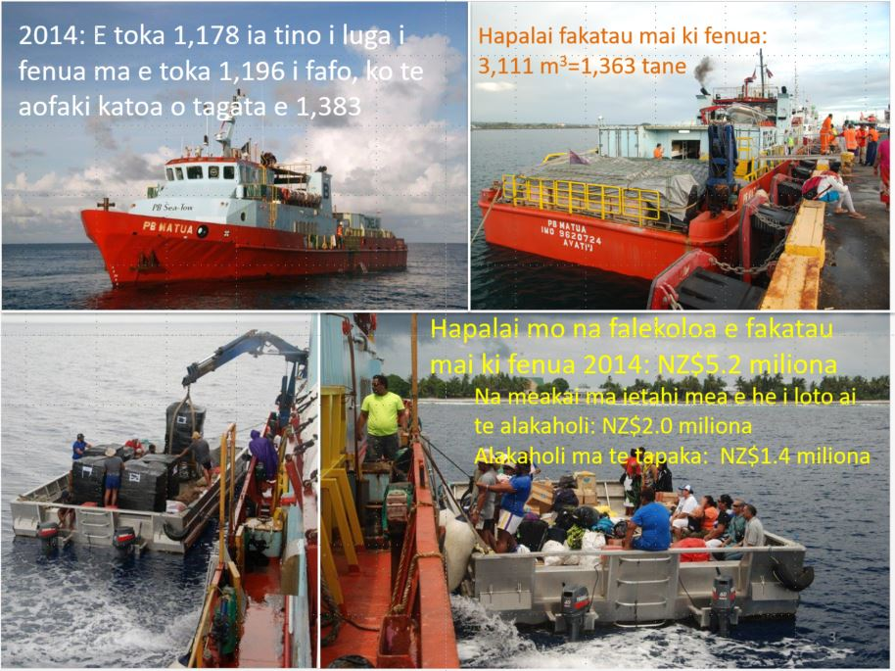
Notes:
Notes:
Quality of life is not just about the policies the government puts into place. It is also about lifestyle and health choices made by individuals. Unfortunately, from an objective statistical perspective, the choices are almost all bad when it comes to eating, drinking, smoking, and producing solid waste. I’m presenting these data to you in the hope that we can improve the situation.

Slide 15
Galulue ma ietahi vaega o te Malo
Ko te fakamaopoopoga o na fuainumela fakamaumau e manakomia lahi lele ai te galulue fakatahi ma ietahi vaega o te malo ma na nuku
Taua lahi o na fuainumela fakamaumau
Mataeke o te Ola malolo; Mataeke o Femalaakiga ma Tautuaga (Lehitala= Fanau, Maliu ma na Faipoipoiga)
Fuainumela tau femalaakiga
Mataeke o Femalaakiga ma Tautuaga
Fuinumela tau manu ma lakau
Department of EDNRE
Ietahi manakoga?
Notes:
Slide:
Working across government
Many collections require active relationships with other departments, and villages
Vital statistics
Department of Health; Department of Transport and Support Services (Civil Registration = Births, Deaths and Marriages)
Migration and Custom statistics
Department of Transport and Support Services
Quarantine statistics
Department of EDNRE
Other needs?

Slide 16
Galulue fakatahi ma ietahi mataeke ote malo (fakaauau)
Mataeke o Akoakoga: Fakamaumauga kina tamaiti akoga ma na faiaoga
Lagolago kite Kauhaga ote Peleni ma Onoono
Onoono ma lipoti na galuega fakatatia ki Niuhila/Mataeke o te Va ki fafo
Ke hui na manatu pe ko na fakatinoga ki te fakaaogagia ona fakamaumauga e te kaufaigaluega tautua
Fehoahoani ki te fakatupu ote fakamaopoopoga aloakia mo te onoonoga ma te peleniga
Fakamatalaga tekinoloti: fakahoahoa na fakamaumauga

Slide 17
Kotokotoga
Ko he polokalame e lahi te fakamoemoegia, kae taikole na lihohi
Manakomia ke mau faiga ma lelei te fakafoega
Ke lelei te fakaaogagia o na avanoa
Fakatulaga! Fakatulaga! Fakatulaga!
E fiafia lahi ke hapoti ma faka taua fehoahoani!
Notes:
Slide:
In summary
An ambitious programme, with few resources
Need to be innovative and coordinated
Make the most of our opportunities
Prioritise! Prioritise! Prioritise!
Keen to support and co-operate!

Slide 18
Kafai e fia fakafehokotaki
Kele Lui – Fakauluulu ki ei te Kauhaga o Fuainumela Fakamaumau
+685 777 4941
kele.lui@tokelau.org.nz
dr Jaap (“iapi”) Jasperse – Hoa Faufautua o Fuainumela Fakamaumau
+685 729 4913
iapi.jasperse@tokelau.org.nz
Mafa Mativa – Ofiha Fuainumela Fakamaumau
+685 774 1778
mafa.mativa@tokelau.org.nz

