Slide 1
Tuhiga Igoa Tokelau 2016
Tomuaga mo na akoakoga agai ki na fuainumela ma faiga tonu
Vaega 1 Atafu (6 Me), Nukunonu (7 Me), Fakaofo (8 Me), ma Apia (11 Me 2017)

Slide 2
Hui o te kauhaga
Ofiha o Fuainumela Fakamaumau o Tokelau
Jaap Jasperse
Mafa Mativa-Fonua
Ofiha o Fuainumela Fakamaumau o Niuhila
Michael Berry
Teresa Evans-Turner

Slide 3
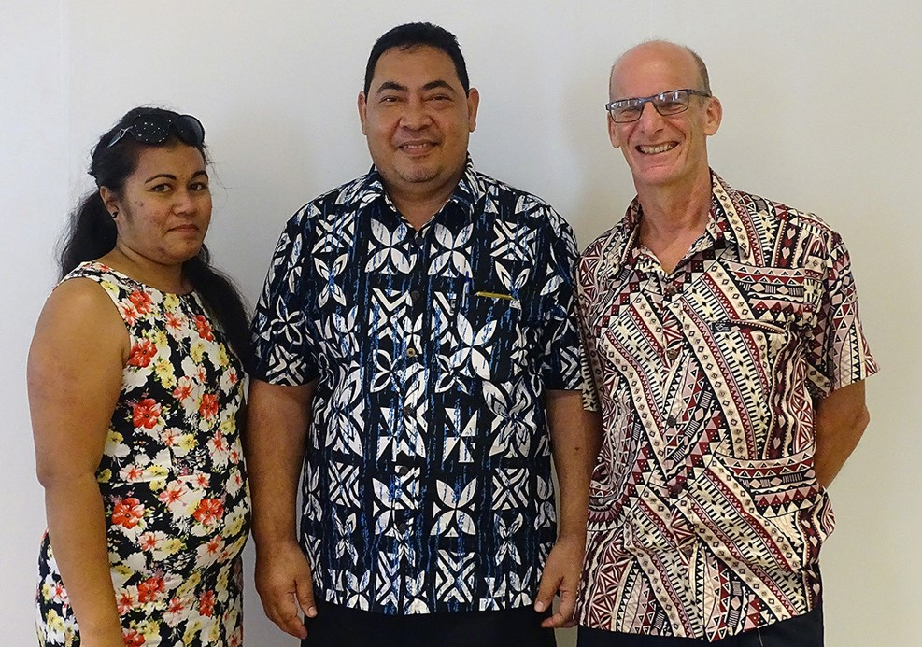
Kaufaigaluega ite Ofiha o Fuainumela Fakamaumau o Tokelau: Kele Lui ko ia te Fakauluulu ki ei te Kauhaga o Fuainumela Fakamaumau o Tokelau (loto tonu); Hoa Faufautua o Fuainumela fakamaumau Jaap
(iapi) Jasperse (Taumatau); Ofiha Fuainumela fakamaumau Mafa Mativa-Fonua (Agavale)

Slide 4
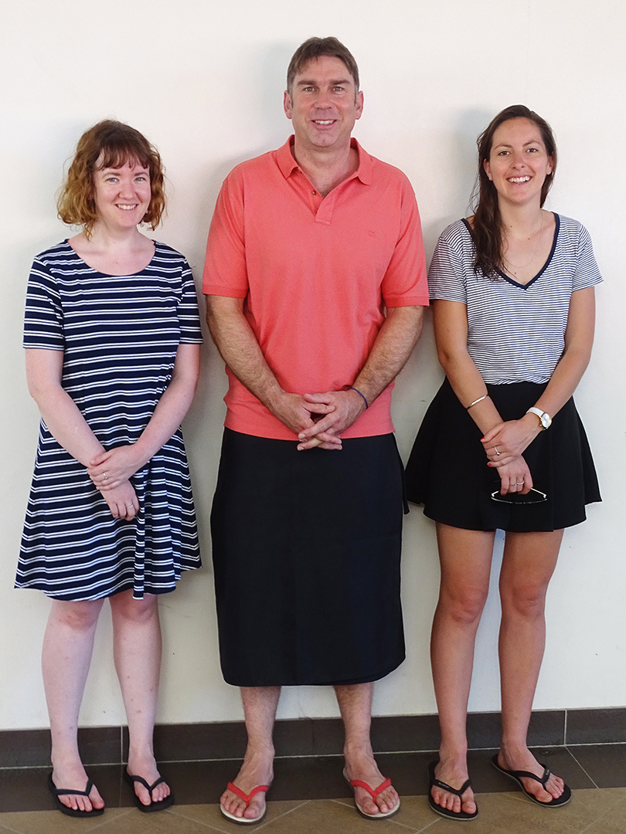
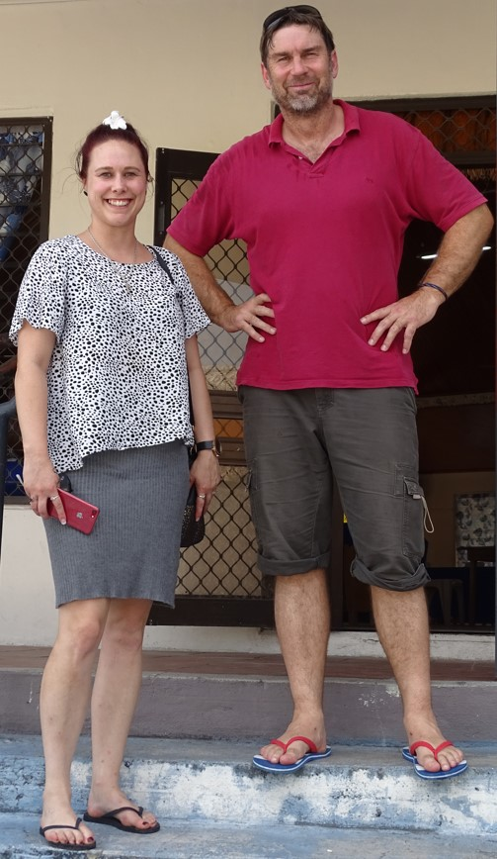
Kaufaigaluega o Niuhila mo Fuainumela
fakamaumau: Avril Macfarlane (L), Sophie Davies (loto tonu), Teresa Evans-Turner ma Mike Berry (x2: i Apia kako heki kamata te tuhiga igoa, ma tea ta i Atafu ina fakatalanoaga ma na nuku ia Me 2017)

Slide 5
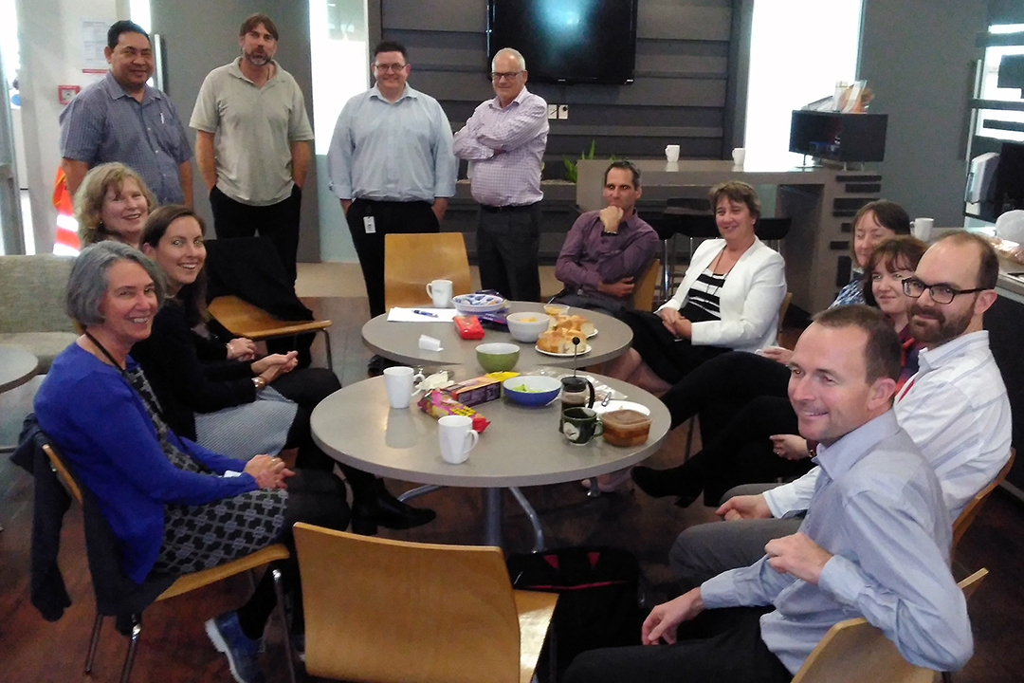
Ko te kaufaigaluega lauaitele mo te Tuhiga igoa a Tokelau mai te vaega o Fuainumela Fakamaumau o Niuhila i Ueligitone

Slide 6
Tokelau ma te StatsNZ
Ko te Ofiha o Fuainumela fakamaumau o Niuhila(StatsNZ) na talohagagia ke tuku mai e ia he takitakiga ma lagolago ki na tuhiga igoa a Tokelau 2006 ma te 2011 ma te 2016
Malo o Tokelau
Ofiha o te Va ki Fafo a Niuhila (MFAT)
Na galulue vavalalata te StatsNZ ma Tokelau i te peleniga, pulega, fakatinoga, tapenaga ke mafai ke tuku atu o na fakamatalaga, ma te fakalauiloga
Tino fakafaigaluega e Tokelau i te 2011-2014 ma te 2014-2016 ma ko i fakaauau pea lava tenei lagolago

Slide 7
Pogai
Ke toe tuku atu kia te koutou na maua mai ai na fakamatalaga
Ke faufautua na vaega tau fuainumela fakamaumau
Galulue ma kilatou e fai tonu, ma keli loloto atili ki loto o na fakamatalaga ki na ikuga o te Tuhiga igoa a Tokelau
Ke lahi atu te aoga o na tupe fakafano a te malo ki te tuhiga igoa

Slide 8
Na vaega e kikila ki ei
Vaega 1– he fakatomuaga agai ki na fuainumela
E fakamaopoopo vehea
E fakalauiloa vehea
Fuainumela faigofie
Vaega 2 – katoaga o te tuhiga igoa
E vehea te fakatinoga
Ko ai te na aofia
Hea te na tupu ki na ikuga

Slide 9
Na vaega e kikila ki ei
Vaega 3 – katoaga o na fuainumela o te tuhiga igoa
E uiga ki Tokelau
Kalafa ma na laulau fakamatalaga
E maua i fea na fakamatalaga
Vaega 4 – fakaaogaga o na fuainumela i na faiga tonu
Auala e fakatino ai te akoakoga
Tulaga o te olaga i Tokelau ma Niuhila

Slide 10
Na vaega e kikila ki ei
Vaega 5 – Ofiha o Fuainumela Fakamaumau a te Malo o Tokelau
Ko ai kimatou ma na galuega kua peleni ke fakatino i na tauhaga ka hohoko mai
E fakafehokotaki vehea kimatou

Slide 11
Tomuaga agai ki na Fuainumela Fakamaumau
Vaega 1

Slide 12
Na vaega e kikila ki ei
Ko ni a na fuainumela fakamaumau
Aihea e fakaaoga ai ni fuainumela fakamaumau
E fakamaopoopo vehea na fuainumela fakamaumau
E fakalauiloa vehea na fuainumela fakamaumau

Slide 13
Ko ni a na fuainumela fakamaumau?
Ko te haienihi o na fuainumela fakamaumau
Ko te haienihi e gafa ma te fakamaopoopoga, fakavahegaga, iloiloga, fakauigaga ona fakamatalaga tau fuainumela pe ni fakamaumauga foki.
Ko matou nei e galulue i na mea tau fuainumela aloakia i te ’
Fakamaopoopoga o na fakamatalaga, ma te fakalauiloga e te Malo o Tokelau
E fakaauau pea, kae e he mo he taimi e fokotahi oioti.

Slide 14
Aihea te fakaaoga ai na fuainumela fakamaumau?
Fuainumela fakamaumau
Tuku atu ni fakamatalaga ke fehoahoani ki te faiga o ni tonu e fakavae ki ni fakamatalaga hako
Fua ai ni mea i he taimi, ma fakaali mai ai na huiga mai teia taimi ki teia taimi
Fehoahoani ke kitea ai ma onoono na huiga
Fehoahoani ke mafai ai ke tau tali atu ki na fakalapotopotoga e tuku maia na tupe ma tagata lautele
Ko te fatu tulimanu ia o he faiga malo lelei

Slide 15
E fakamaopoopo vehea na fuainumela fakamaumau?
E tolu ia vaega lalahi
Tuhiga Igoa
E aofia uma ai ia tagata; Taugata, tuai ma e he ia mafaia oi gafa ma na fakamatalaga faigata
Hakilikiliga
E kikila oioti ki he vaega o te aofaki o tagata; E mahani lava oi taugofie, kae e faigata ke fakatino i Tokelau
Fakamaumauga i na galuega fakatino
Fakamatalaga e mahani fakamaopoopo i luga ona galuega mahani ft fakamaumauga tau tupe, aofaki o te tuau e kaumai ki Tokelau; Kafai e lelei te faiga ma te taukikilaga, e lelei na fakamatalaga e maua mai ai ma taugofie

Slide 16
Fekuikuifakiga

Slide 17
Fakapaleniga o na fuainumela fakamaumau aloakia
Lave: | Manakoga:
Fakaauauga mai teia taimi ki teia taimi | Talafeagai mo na aho nei
Fakafita ki tagata | Manakoga tau fakamatalaga
Kikila he fakaitu kau | Tau tali mai
Manakoga tau pulega | Manakoga tau fuainumela fakamaumau
Hako katoatoa | Taimi
Malu puipuia | Mafai ke maua na fuainumela fakamaumau

Slide 18
Otaota ki loto, otaota ki fafo
He famahino Igilihi na fai ta na matakupu agai ki na fuainumela fakamaumau o Initia:
Ko te malo nae fofou lahi lele ke fakamaopoopo na fuainumela fakamaumau. Nae fakamaopoopo e kilatou,fai a latou hakilikiliga e lahi ki ei ina auala o te numela ke mafai ke tuku atu ai ki te lauaitele. Kae ehe mafai ke puli ai ko na fakamatalaga ienei ma na ata nae maua mai I he tino leoleo na fakamolemole lahi mo ienei fakamauamauga.
Sir Josiah Stamp

Slide 19
E fakalauiloa vehea e kimatou na fuianumela fakamaumau
Kupu
Laulau fakamatalaga
Kalafa
Kotokotoga faka fuainumela fakamaumau

Slide 20
E fakalauiloa vehea e kimatou na fuianumela fakamaumau: Kupu
I te 18 Oketopa 2016, e toka 1,285 ia tino nae i luga o Tokelau. Ko te fuainumela tenei e aofia uma lele ai na tino nae i luga o Tokelau ite po o te Tuhiga igoa,fakatahi ai ma na tino ahiahi mai fafo. Ko na tino nae i fafo o Tokelau i te po o te tuhiga igoa e he aofia i loto o te fuainumela tenei.

Slide 21
E fakalauiloa vehea e kimatou na fuianumela fakamaumau: Laulau fakamatalaga
Atoll of usual residence | De jure usually resident population |  | Increase or decrease(-) 2011-2016
 | 2011 | 2016 | Number | Percent
Atafu | 482 | 519 | 37 | 7.7
Fakaofo | 490 | 484 | -6 | -1.2
Nukunonu | 397 | 448 | 51 | 12.8
Samoa | 42 | 48 | 6 | 14.3
Total | 1,411 | 1,499 | 88 | 6.2

Slide 22
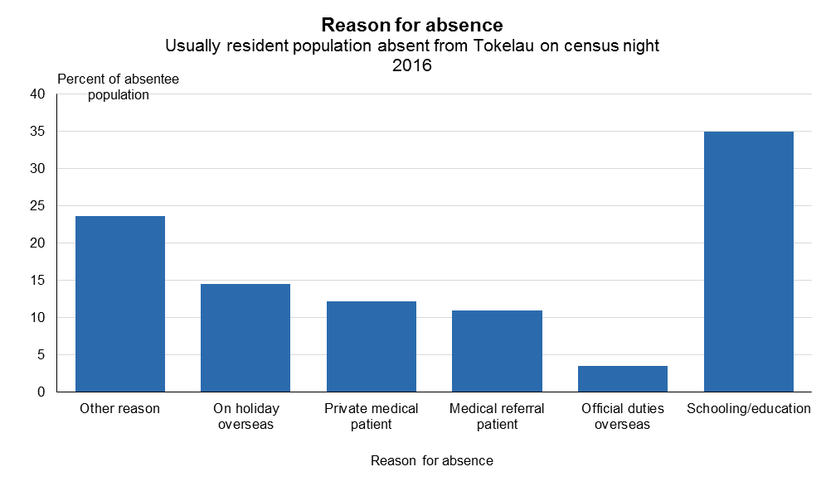
E fakalauiloa vehea e kimatou na fuianumela: Kalafa

Slide 23
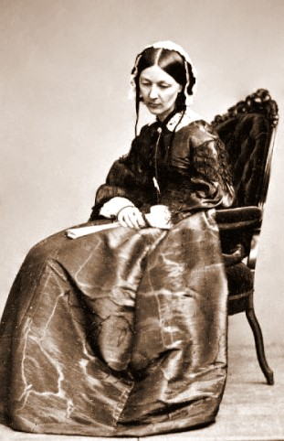
Ko ai tenei?

Slide 24
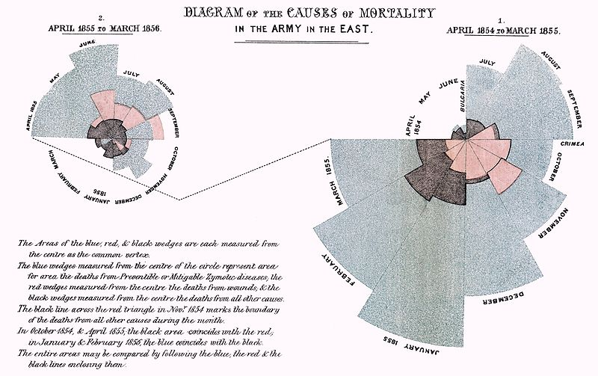
Ko te matua kia Florence Nightingale i te 1858

Slide 25
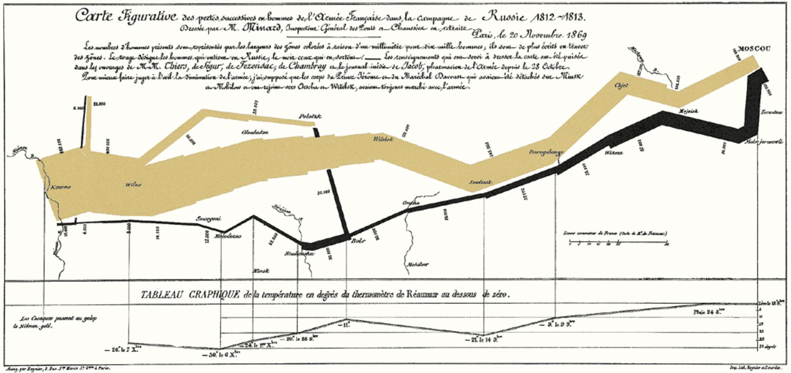
Ko te kau fitafita i te havaliga e taku ko te Napolean i te 1812 na takitaki ai ia Charles Joseph Minard (1869)

Slide 26
E fakalauiloa vehea e kimatou na fuianumela fakamaumau
Kotokotoga faka fuainumela fakamaumau
Pito taigole
Pito maualuga
Kehekehega = Pito maualuga – Pito taigole
Pito ki loto tonu = fuainumela I ‘lot tonu’ e vaelua ai na fakamaumauga ki ni vaega e lua
Fuainumela takalahi = ko te fuainumela pito takalahi
Numela takalahi = ko te numela ia i loto o ni akilikiliga pe ni fakamaumauga e maua ki ei te paleni mai te numela pito ki luga ma te numela pito ki lalo

Slide 27
Fakamatalaga o na fuainumela fakamaumau
Pahene (%) = he vaega eo te aofakiga
Huiga kite pahene = e fua ai na huiga mai te ia taimi ki te ia taimi
Numela o kilatou na tali mai = pe toka fia kilatou na mafai ke tali mai ki he fehili

