Slide 1
Tuhiga Igoa Tokelau 2016
Vaega 3 Kotokotoga o te Tuhiga Igoa

Slide 2
Fakamatalaga e maua

Slide 3
Changes in de jure usually resident population count by atoll
Atoll of usual residence | De jure usually resident population |  | Increase or decrease(-) 2011-2016
 | 2011 | 2016 | Number | Percent
Atafu | 482 | 519 | 37 | 7.7
Fakaofo | 490 | 484 | -6 | -1.2
Nukunonu | 397 | 448 | 51 | 12.8
Samoa | 42 | 48 | 6 | 14.3
Total | 1,411 | 1,499 | 88 | 6.2
Notes:
Slide:
[table not translated]
Notes:
Slight increase in population since 2011 – 6.2%

Slide 4
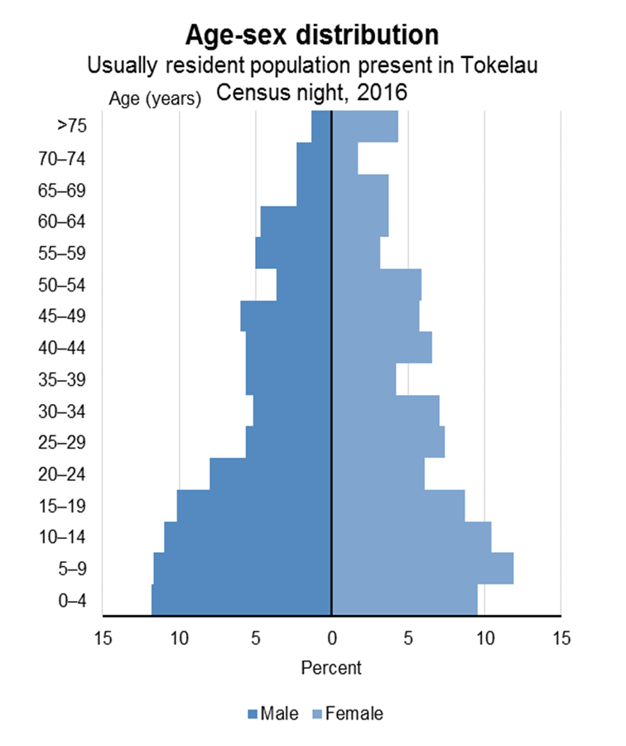
Notes:
Slide:
[graph not translated]
Notes:
The figure widens at the base, showing that Tokelau has a youthful population.
The shape starts to narrow from the 35–39 age group, with fewer people in these older age groups.
It becomes particularly narrow for the 65+ age groups, with only 12% of the population being 65+.
The median age for the usually resident population present in Tokelau on census night was 25 years. In 2006 the median age was 22 years and in 2011 it was 24 years.
In 2016, the median age for males was 23 years and 27 years for females

Slide 5
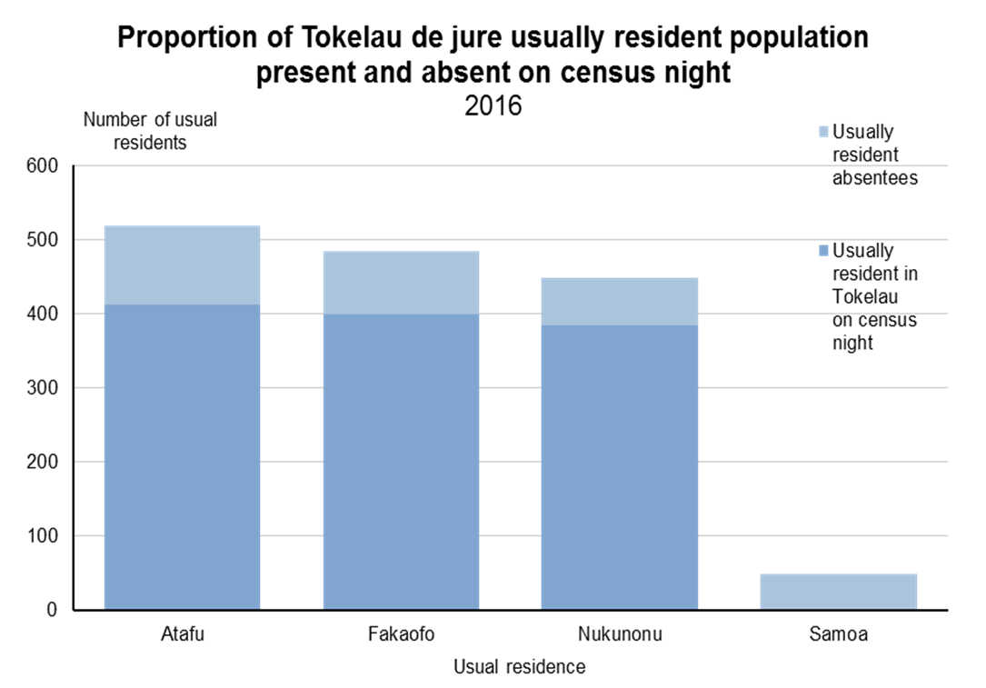
Notes:
Slide:
[graph not translated]
Notes:
One fifth of the population were away on census night

Slide 6
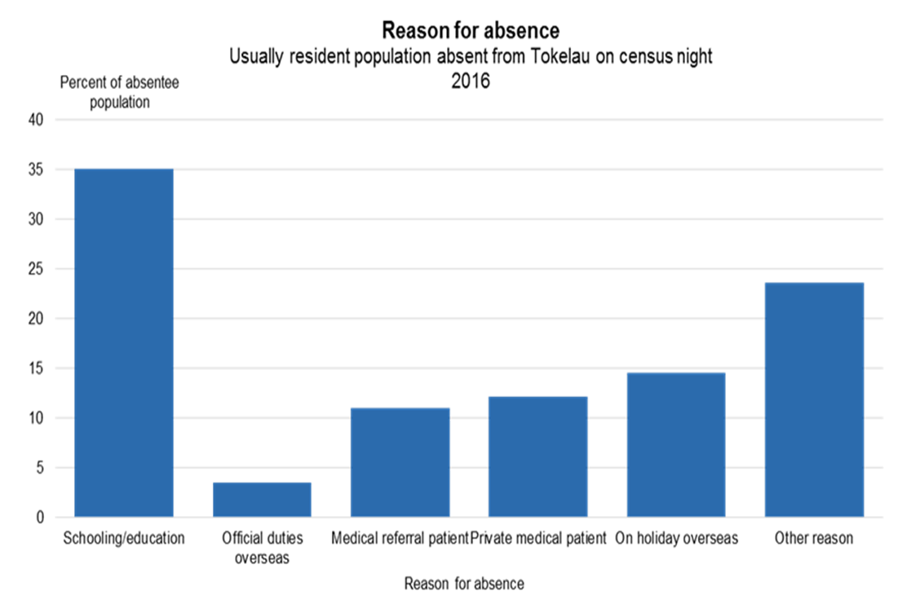
Notes:
Slide:
[graph not translated]
Notes:
The most common reason for absence was for schooling or education (35.0 percent). Up from 2011, whe n26.1 percent of absentees were away for education.
Being away on holiday overseas (14.6 percent), and being a private medical patient (12.2 percent) were the next most-common reasons for absence.
‘Other’ reasons – includes family commitments, accompanying family on a medical referral, or who are overseas studying. Some people were overseas to attend a funeral.

Slide 7
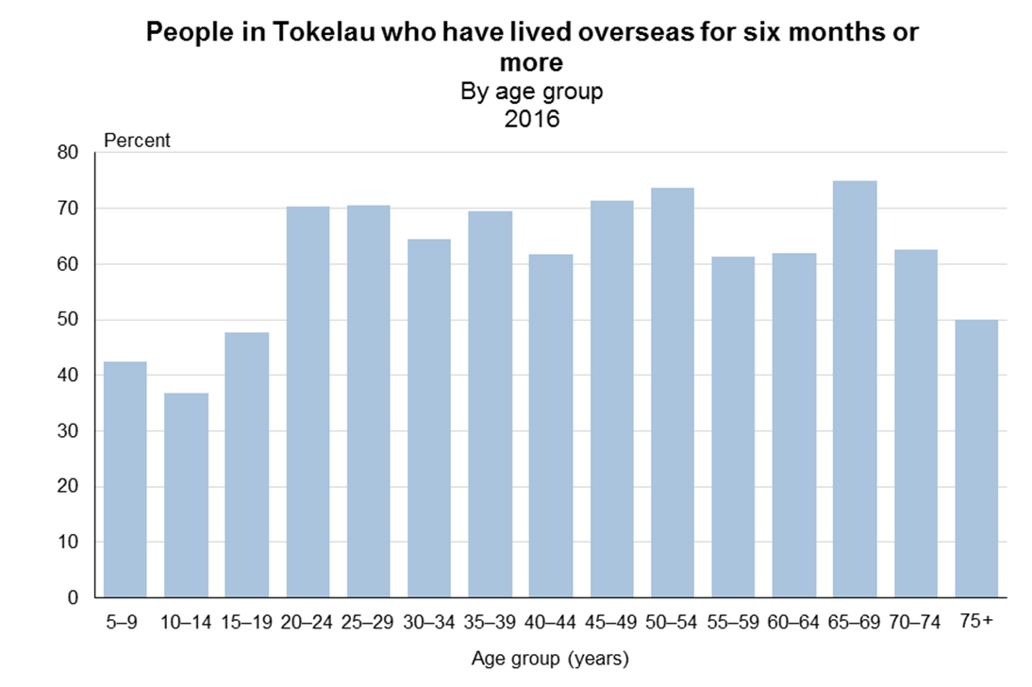
Notes:
Slide:
[graph not translated]
Notes:
In 2016, just over half the usual residents (55%) were born in Tokelau.
In addition to the high number of people born overseas, a majority (59%) of Tokelau’s population had lived overseas for at least six months (see graph).

Slide 8
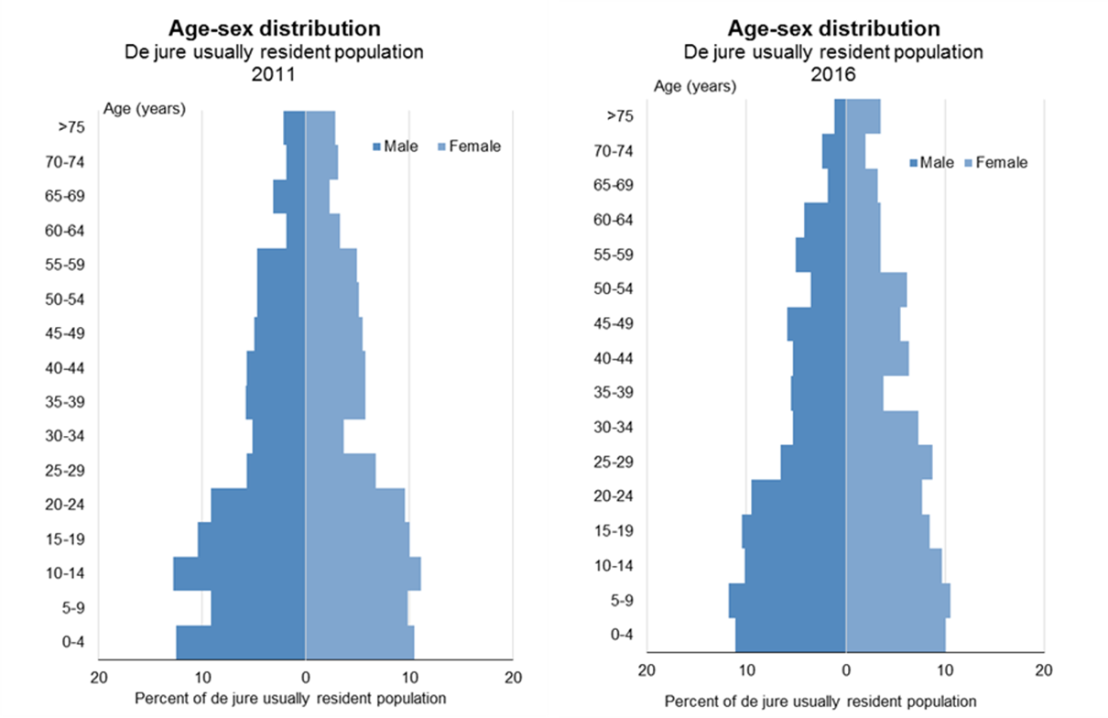
Notes:
Slide:
[graph not translated]
Notes:
Overall the age-sex distributions in 2011 and 2016 are relatively similar. The shapes both have broad bases then narrow from age 30 years.
5–9-year-olds increased between the 2011 and 2016 Censuses, particularly for males. 10–14-year-olds fell.
For the 25–29 and 30–34-year age groups, the shape widens in 2016.
The changes could be due to many factors – eg birth rate mainly responsible for change in the 0–4 age group, whereas migration is likely to be the main reason behind changes in the middle age groups (25–59 years).

Slide 9
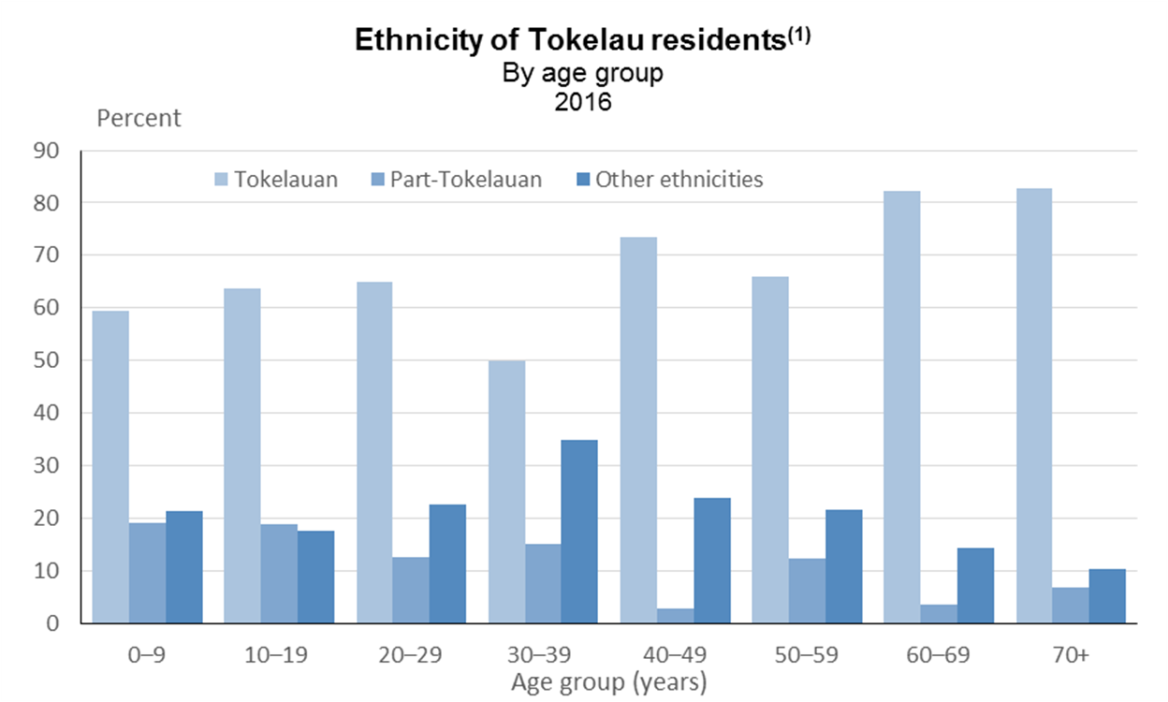
Notes:
Slide:
[graph not translated]
Notes:
Older age groups more likely to identify as full-Tokelauan ethnicity. Younger age groups higher proportions identifying as either part-Tokelauan or other ethnicities.
While the proportion of each group identifying as full-Tokelauan generally increases from the youngest to the oldest age group, people aged 30–39 years had the lowest proportion of full-Tokelauans (50%).

Slide 10
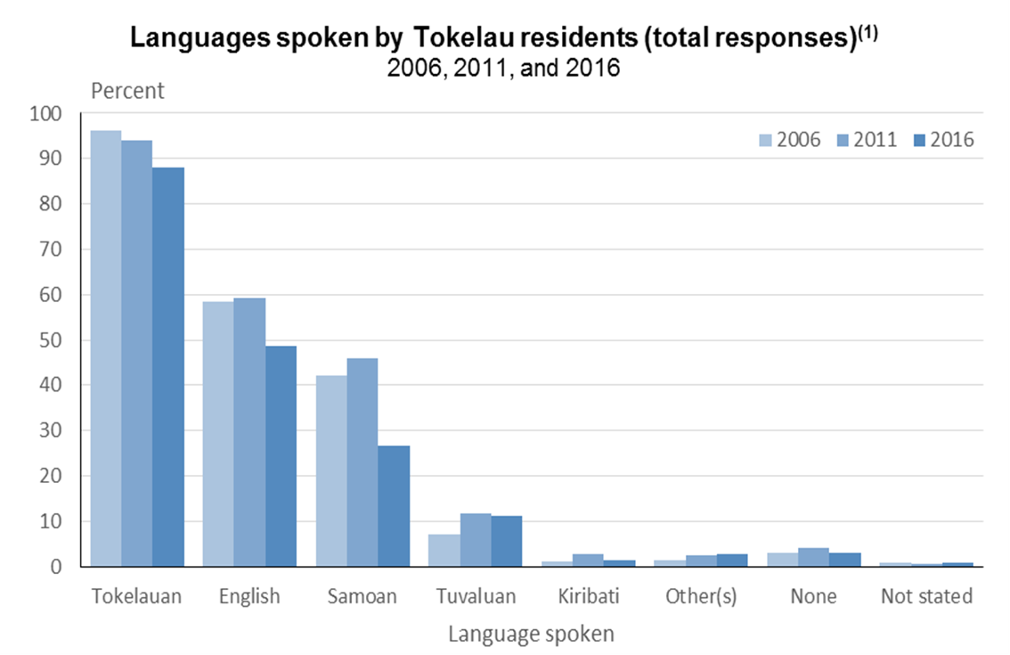
Notes:
Slide:
[graph not translated]
Notes:
In the census, we ask Tokelauans which languages they can have an everyday conversation in. 88% can converse in Tokelauan.
English was the second most-commonly spoken language - 49 percent then Tuvaluan 11%.
Half the population (52%) spoke two or more languages in 2016.

Slide 11
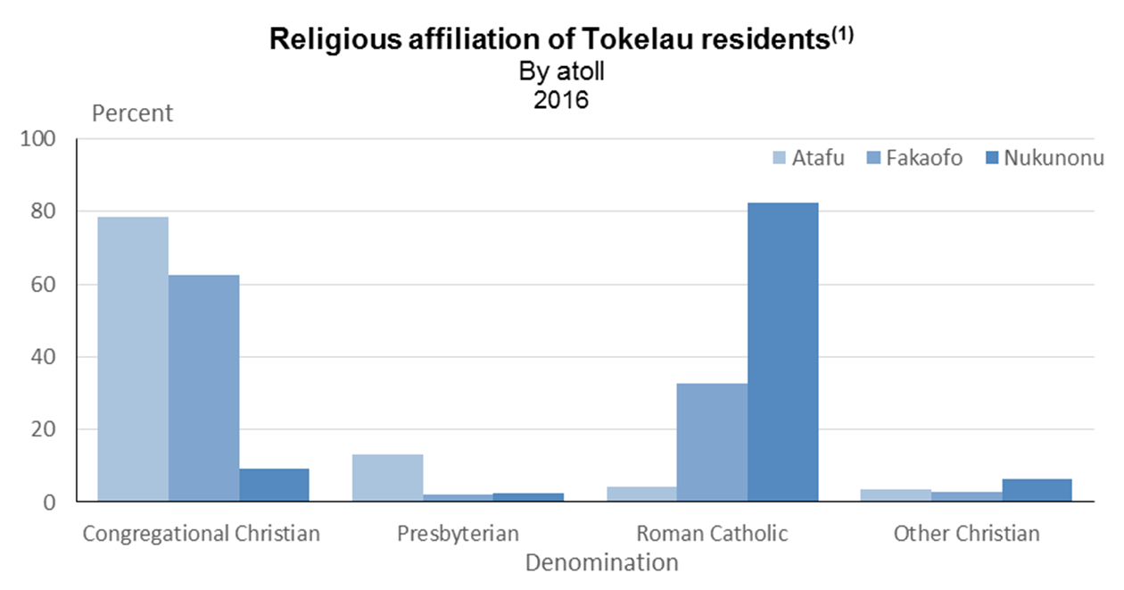
Notes:
Slide:
[graph not translated]
Notes:
Religion maintains importance in Tokelau
There is a significant difference across the three atolls. Congregational Christian is the major denomination on both Atafu and Fakaofo, with 78% and 63% respectively, while on Nukunonu 82% identified as Roman Catholic.

Slide 12
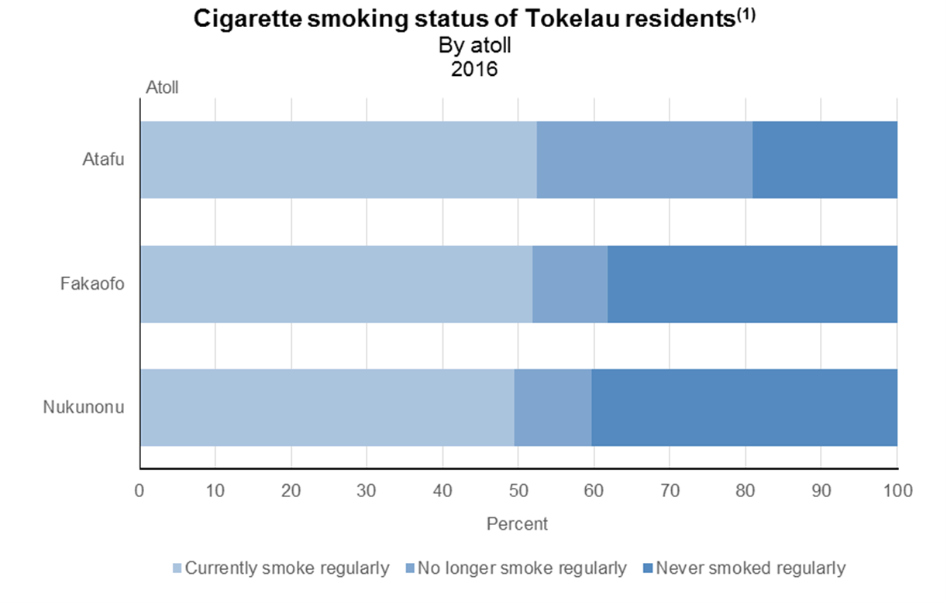
Notes:
Slide:
[graph not translated]
Notes:
In the 2016 Census, half of all adults reported they smoked regularly.
Atafu had the highest proportion (81%) of those who had EVER smoked regularly. Fakaofo and Nukunonu had much lower rates for people who had ever smoked, 62% of Fakaofo residents, and 60 percent of Nukunonu residents.

Slide 13
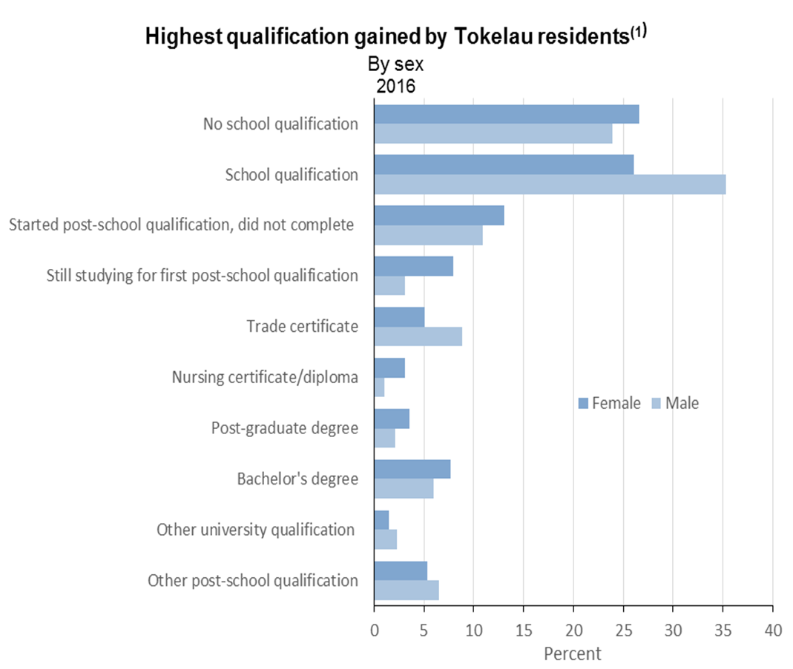
Notes:
Slide:
[graph not translated]
Notes:
For a third of Tokelauans (31%), a school qualification was their highest educational qualification in 2016. (Males 35%, Females 26%)
Males were more likely to hold a trade certificate
Females were more likely to have a degree-level qualification (bachelor’s or postgraduate).
Proportion of females still studying at tertiary level was also higher than for males

Slide 14
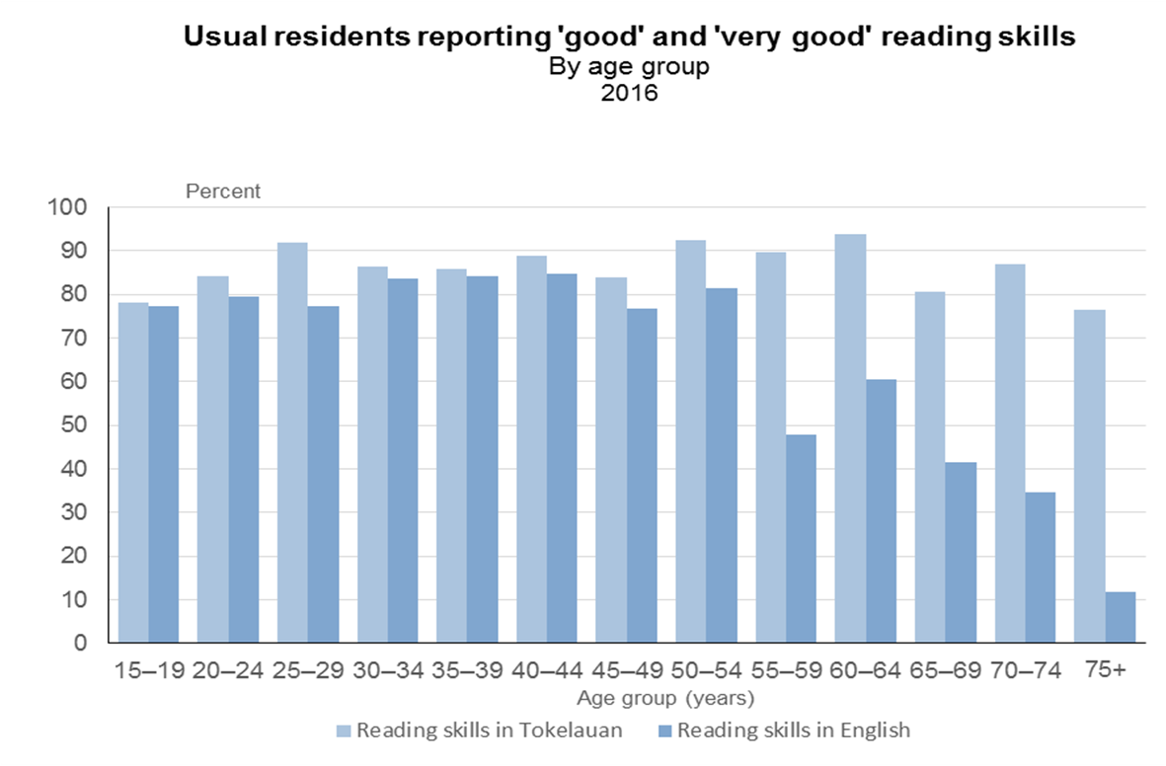
Notes:
Slide:
[graph not translated]
Notes:
Older people were less likely than younger to have good or very good reading skills in English.
Note decrease in English reading skills from age 55 years. Overall, 71% reported having good or very good reading skills in English but only 12 percent of people aged 75+ had the same skill level.
In contrast reading skills in Tokelauan were high (between 77 and 94 percent) across all age groups.

Slide 15
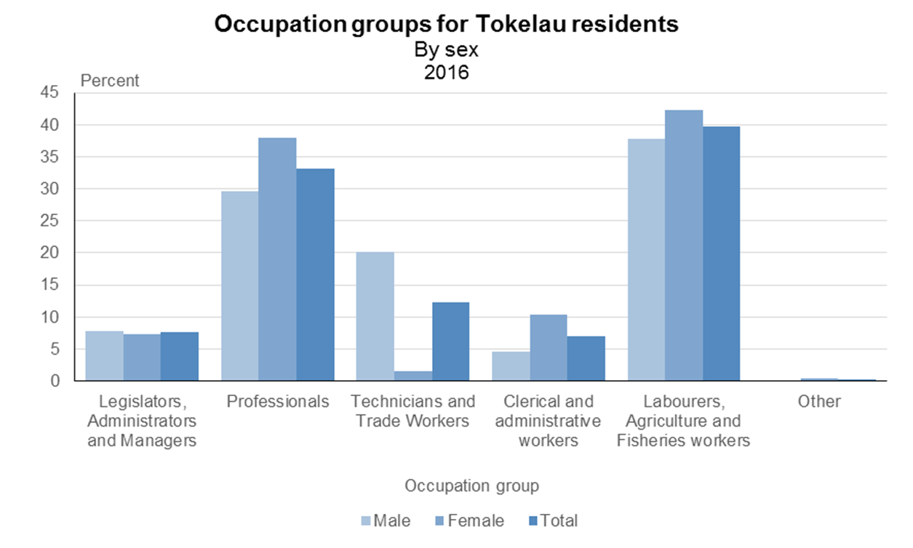
Notes:
Slide:
[graph not translated]
Notes:
Women more likely to be in the professional group than men. (38% were professionals, compared with 30% of men).
Men much more likely than women to be technicians and trade workers (20% of men, and 2% of women).

Slide 16
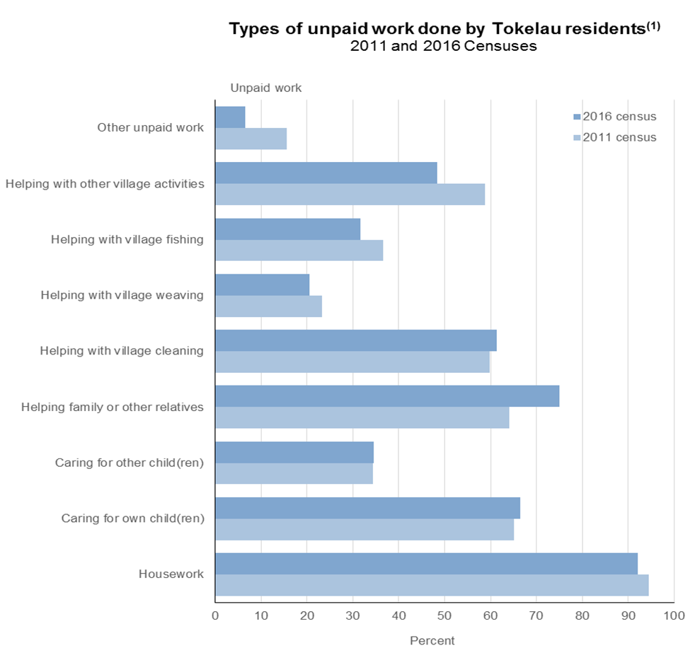
Notes:
Slide:
[graph not translated]
Notes:
Unpaid work contributes a great deal to the daily running of Tokelauan society.
Most usual residents (79%) aged 15+ years were involved in unpaid work in the week before the 2016 Tokelau Census.
Contribution of unpaid work has fallen since 2011. The biggest decrease was in helping with other village activities.
The only main increase was in helping family or other relatives

Slide 17
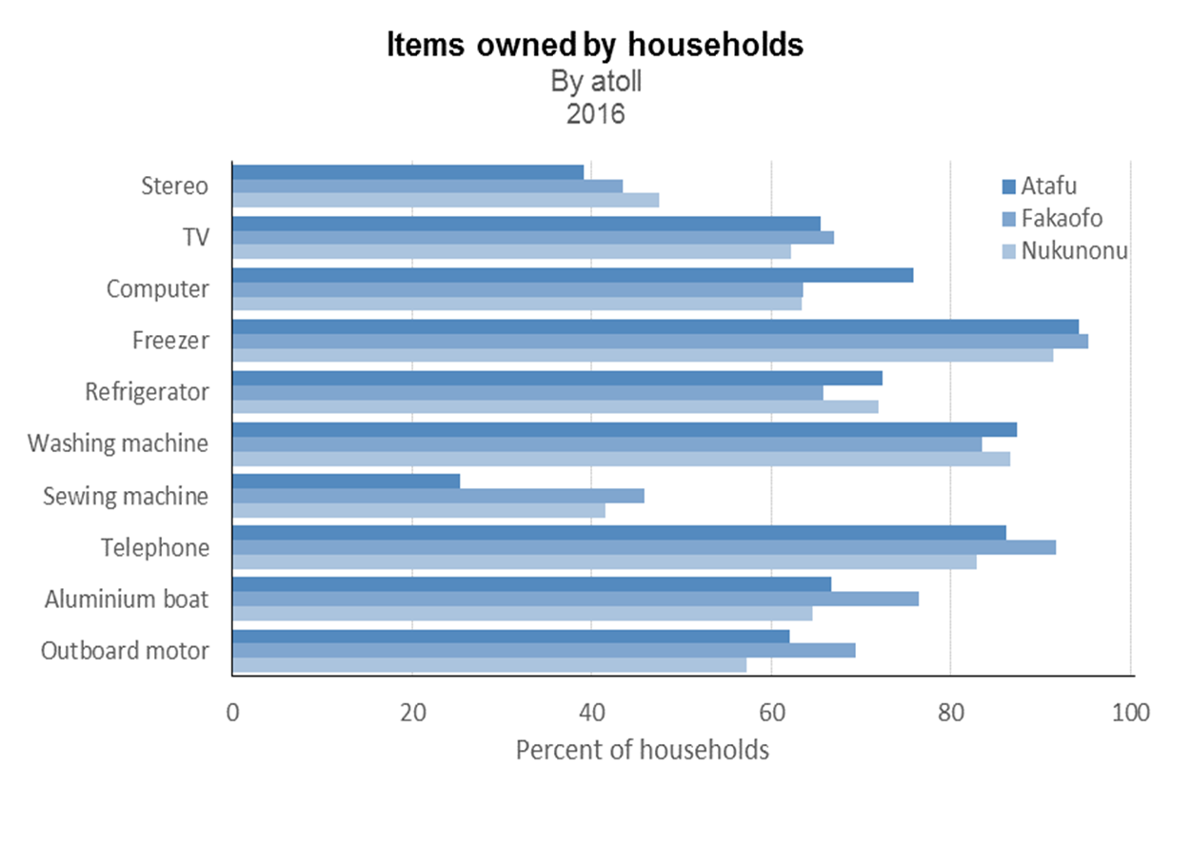
Notes:
Slide:
[graph not translated]
Notes:
Freezers were the most commonly owned items across all three atolls. Telephones and washing machines were also commonly owned items.

Slide 18
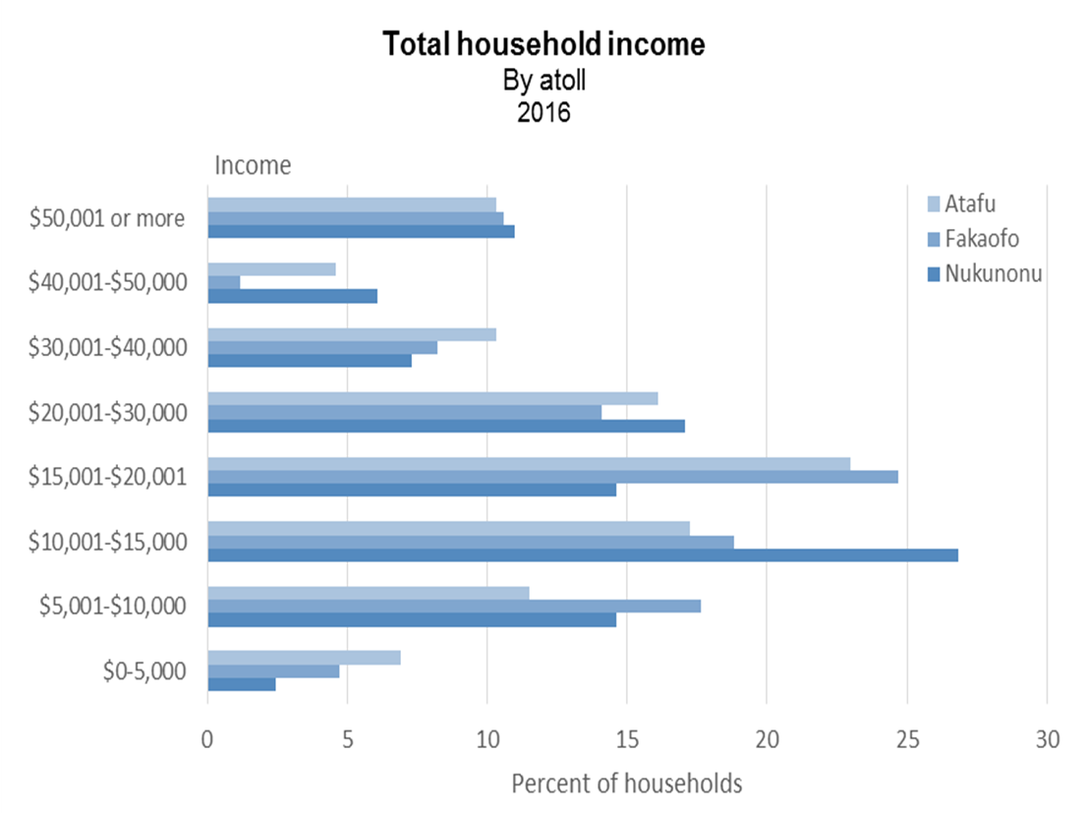
Notes:
Slide:
[graph not translated]
Notes:
Median income $17,500
Relatively normal distribution of household income in Tokelau, centred on the $15,001-$20,000 bracket.
However, there is a higher than expected concentration of households in the highest income bracket; $50,001 or more per annum.

Slide 19
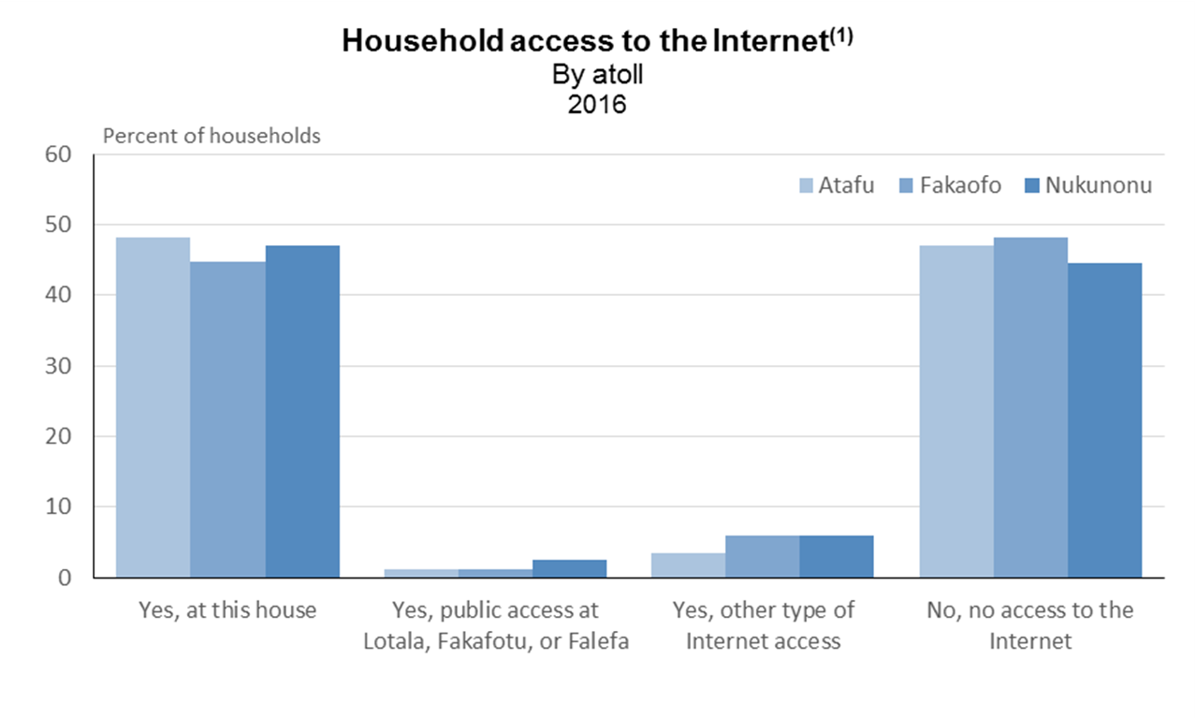
Notes:
Slide:
[graph not translated]
Notes:
Most common type of access to internet was privately purchased internet access.
On all atolls, at least half of households had access to the internet either through privately purchasing it at their house, through public access, or another type of access.
Nukunonu had the highest proportion of households (55%) who could access the internet in some way.

Slide 20
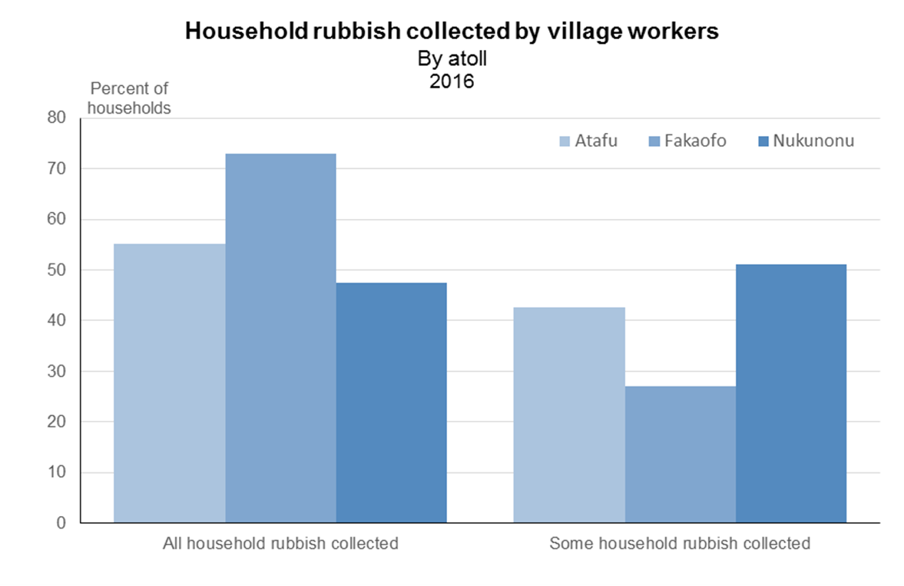
Notes:
Slide:
[graph not translated]
Notes:
Most household rubbish collected by village workers – 99% of all households had at least some rubbish collected.
Fakaofo had the highest proportion of households where all rubbish was collected by village workers (73%). All households in Fakaofo had at least some household rubbish collected.
Nukunonu had the lowest proportion (48%) of households across the three atolls where all household rubbish was collected.

Slide 21
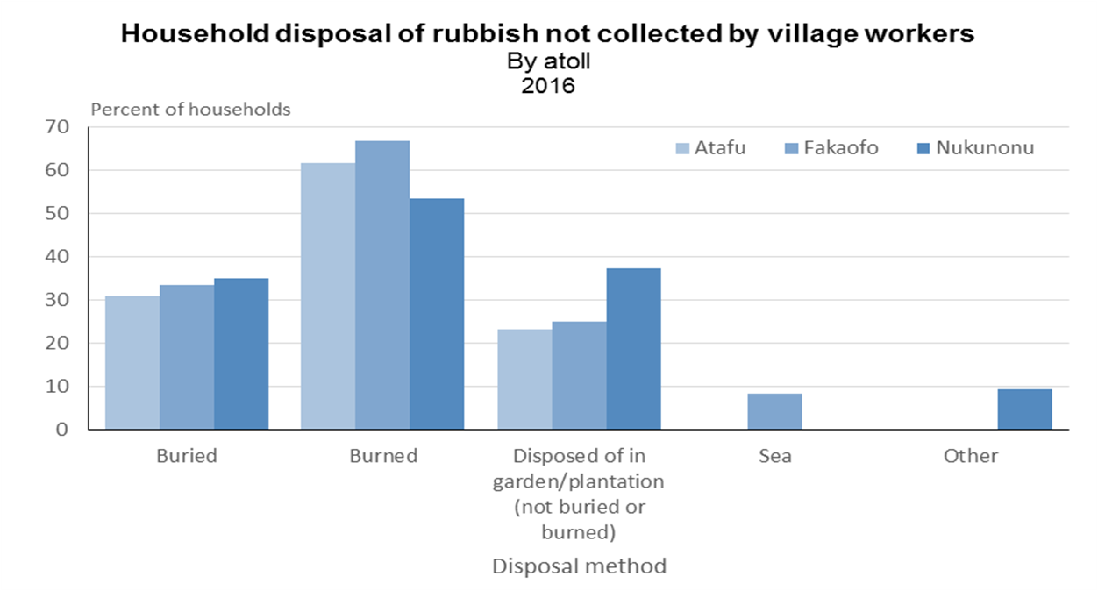
Notes:
Slide:
[graph not translated]
Notes:
Burning is the most common method of disposal in all three atolls. Nukunonu (54%) Atafu (62%) and Fakaofo (67%).
For Atafu and Fakaofo the next most common method of disposal was burying. For Nukunonu the second most common method is disposing of rubbish in gardens or plantations.

Slide 22
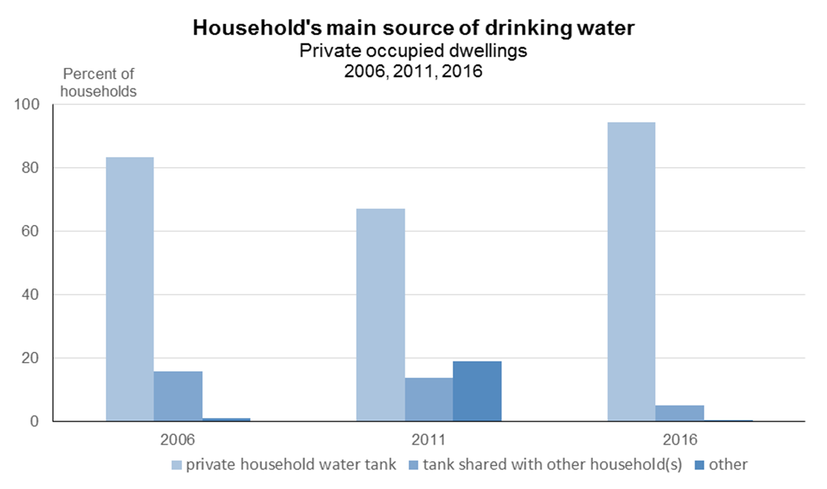
Notes:
Slide:
[graph not translated]
Notes:
Much higher proportion of households had a private water tank as their main water source (95 percent) in 2016 compared to 2011 (67 percent) – shows impact of the 2011 drought.
The proportion of households using a private water tank as their main water source was slightly higher than in 2006 (83%) when there was also no drought. Significant moves have been made over the last few years to increase the capacity of water tanks for private dwellings, which may explain some of the increase in private water tank use.

Slide 23
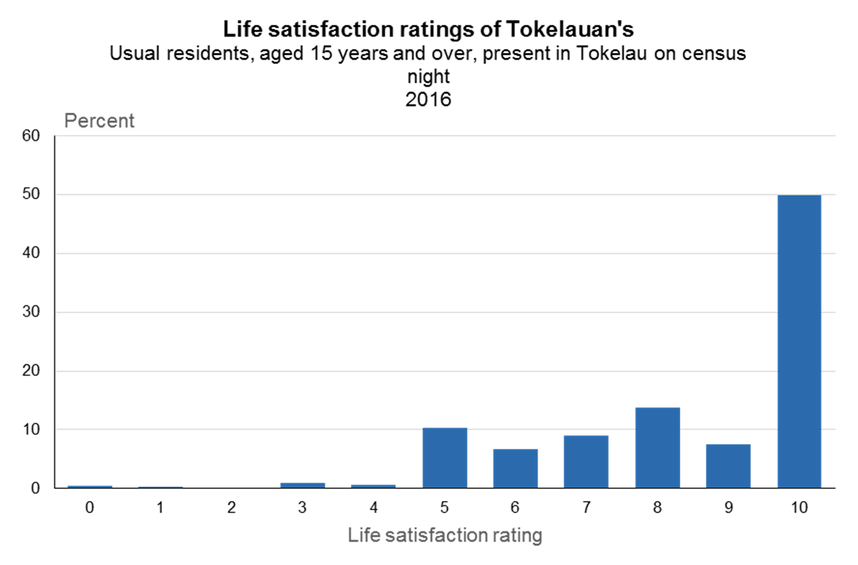
Notes:
Slide:
[graph not translated]
Notes:
Overall, people reported very high levels of life satisfaction. Almost ¾ of all residents (71%) rated it at 8 or higher; only 2.5% gave a rating of 4 or lower.
The most-common response was 10 (50%). The next most-common response was 8 (36%). These results indicate that the majority of people were satisfied with their lives in Tokelau.
All three atolls had a similar distribution of life satisfaction rating.

Slide 24
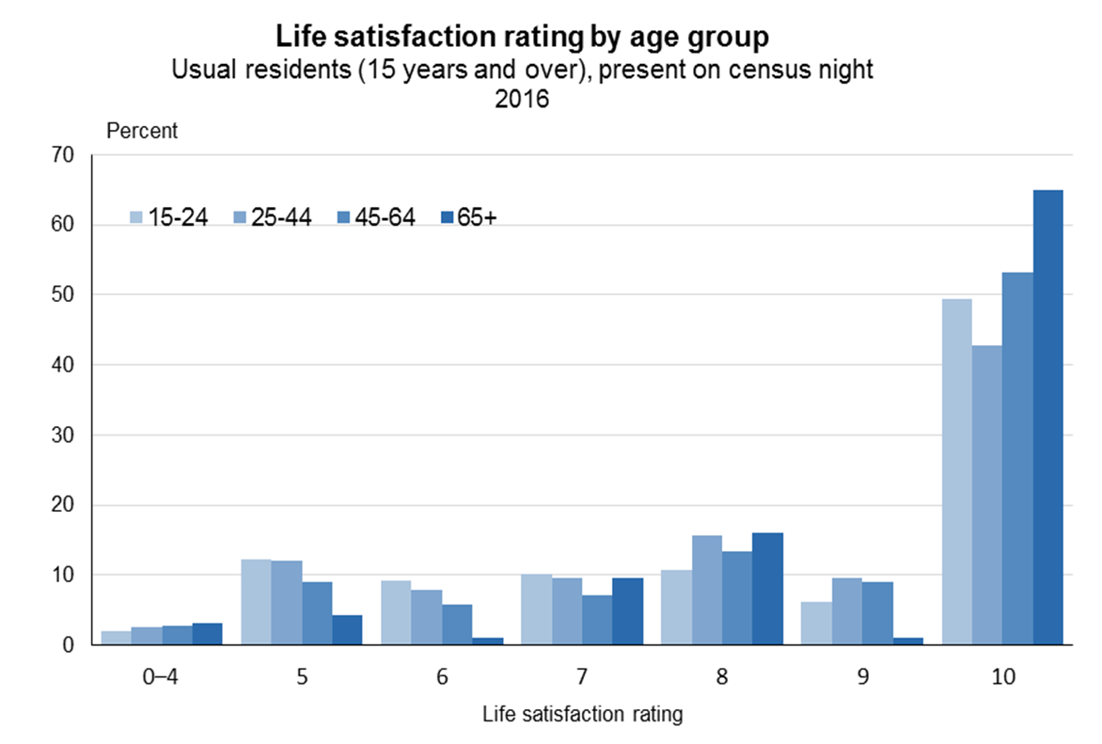
Notes:
Slide:
[graph not translated]
Notes:
Life satisfaction increases with age. The 65+ age group had the highest proportion of people who rated their life satisfaction as 10 (65%) . In contrast, for people aged 25-44 years only 43% gave a rating of 10.
For all age groups similar proportions (all under 5 percent) rated their life satisfaction at 4 or lower.

Slide 25
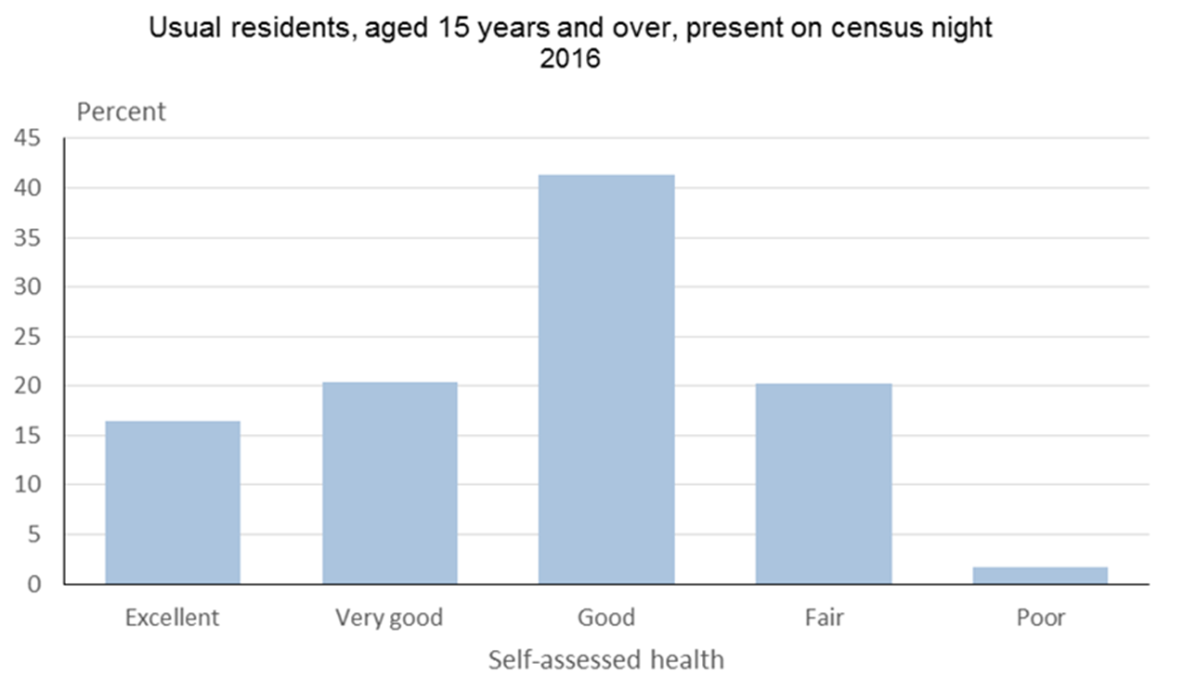
Notes:
Slide:
[graph not translated]
Notes:
For Tokelau, the most-common self-assessment of health rating was ‘good’ (41%). There were very few people who assessed their health as poor (less than 2%)

Slide 26
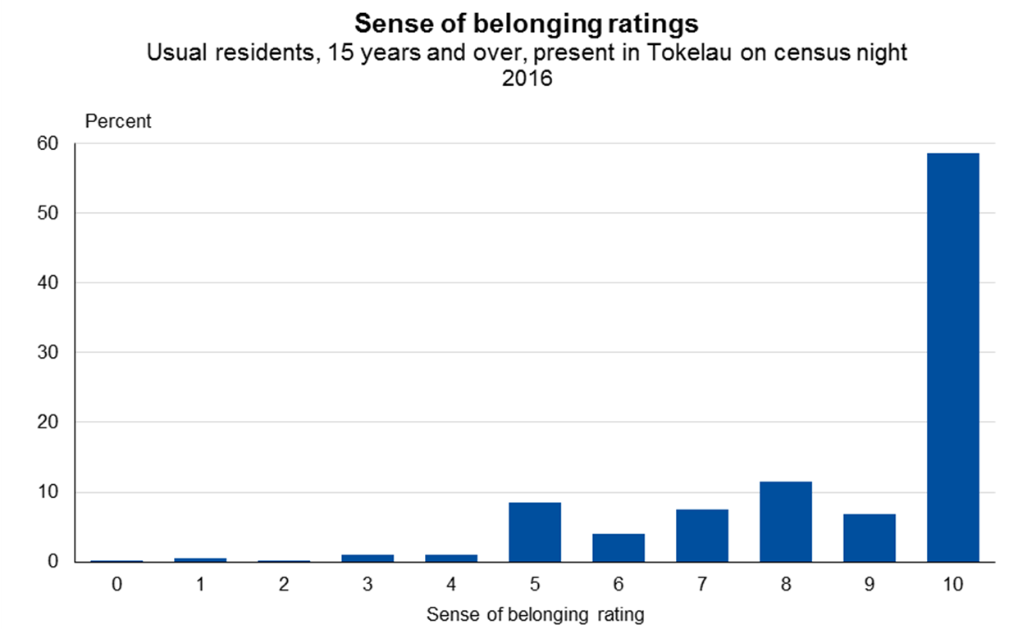
Notes:
Slide:
[graph not translated]
Notes:
Strong sense of belonging exists among residents - results were similar to those for life satisfaction. 59% rated their sense of belonging to the community at 10. Only 3% of residents gave a rating below 5.

Slide 27
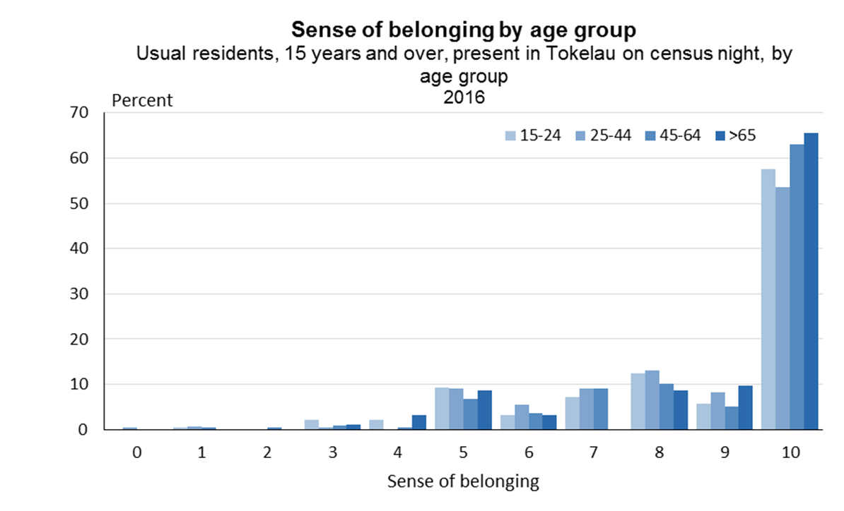
Notes:
Slide:
[graph not translated]
Notes:
Sense of belonging increases with age – slightly higher proportion of older people rated their sense of belonging at 10.
Ratings of 10 varied from 54% for people aged 25–44 to 65% for those aged 65+ years.

Slide 28
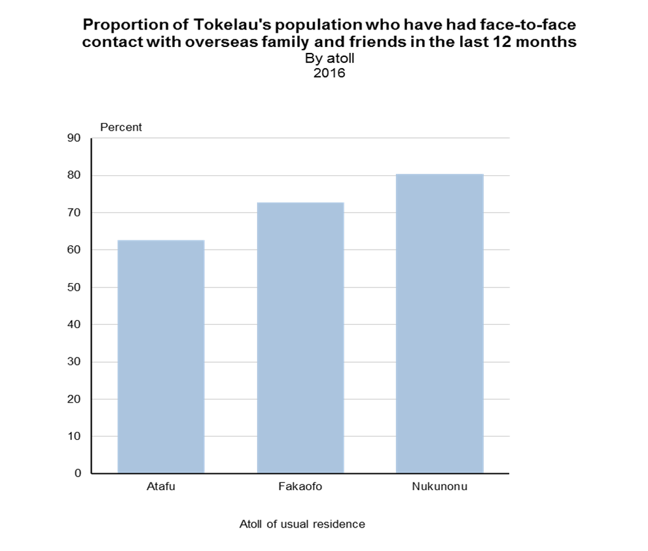
Notes:
Slide:
[graph not translated]
Notes:
Most residents 15+ years (72% ) had seen their overseas family and/or friends in person in the last 12 months.
On Nukunonu, 80% of residents had seen their family/ friends in the last year. This was much higher than the proportion of Atafu residents (63%) and almost 10 percentage points higher than for Fakaofo residents (73%)

Slide 29
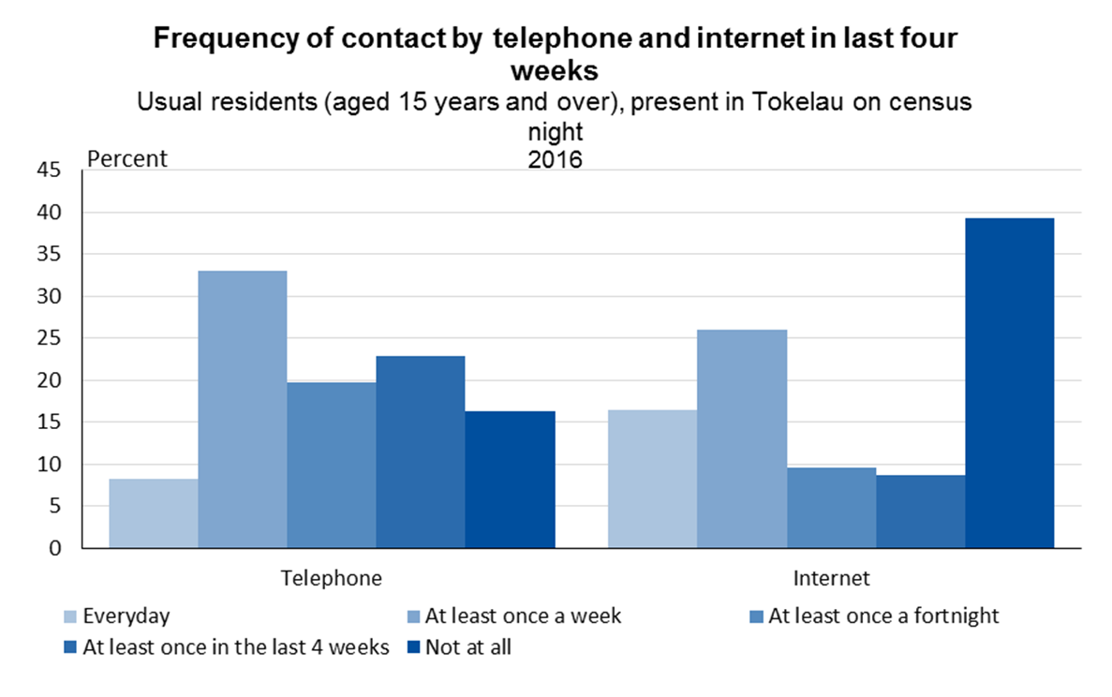
Notes:
Slide:
[graph not translated]
Notes:
Of those Tokelauans who contacted family and/or friends every day, more used the internet (16%) than the telephone (8%).
However, for people who contacted their overseas family and/or friends less frequently, more used the telephone.
More people said they never used the internet to contact their family and/or friends (39%) than those who never used the telephone (16%).
The internet seemed to allow more-frequent contact with overseas friends and family, whereas telephone contact was favoured for less-frequent contact.

Slide 30
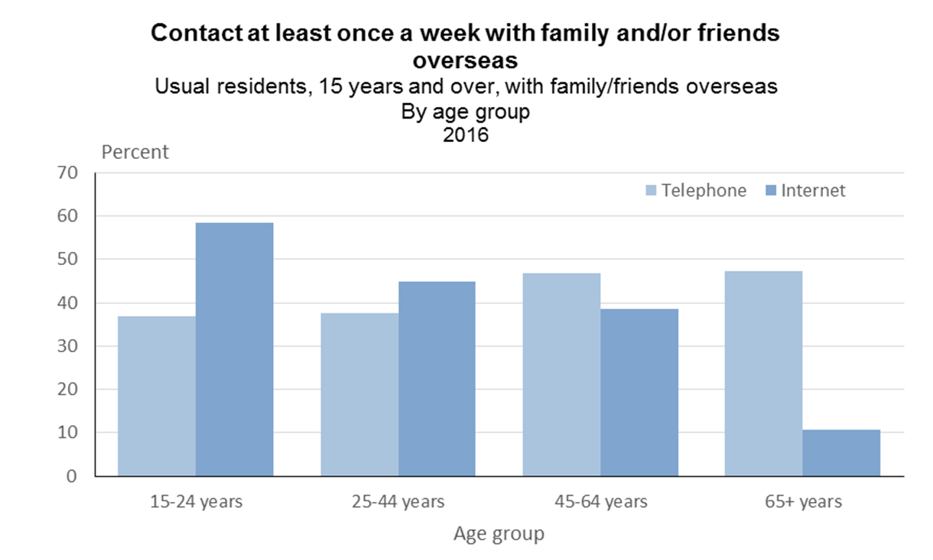
Notes:
Slide:
[graph not translated]
Notes:
More young people used the internet to contact their family and/or friends overseas.
The youngest age group showed the biggest difference – 59% used the internet and 37% used the telephone.
From age 45 onwards, more likely to use the telephone.
The biggest difference was for the 65+ age group - only 11% used the internet, but 47% contacted friends and/or family at least once a week using the telephone.

Slide 31
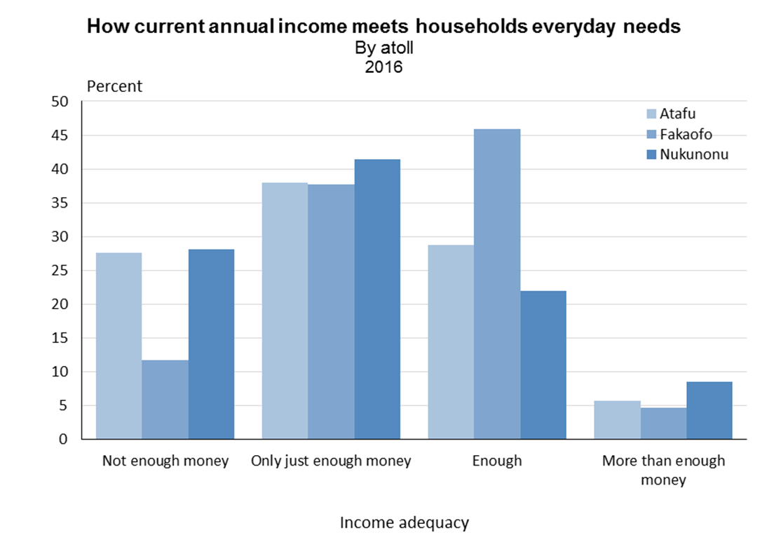
Notes:
Slide:
[graph not translated]
Notes:
Small proportion of households (6%) felt they had more than enough money.
39% considered their yearly income to be ‘only just enough money’ to meet their everyday needs.
Fakaofo showed a major difference to the other two atolls – 46% of its households had ‘enough’ money to meet their everyday needs, compared with 29% for Atafu and 22% for Nukunonu. Fakaofo also had a much lower proportion of households (12%) that said they did not have enough money.

Slide 33
Notes:
For all information go to the National Stats Office page of the Tokelau Official Government Website - or access the pages through the Stats NZ website (show next slide)

Slide 34
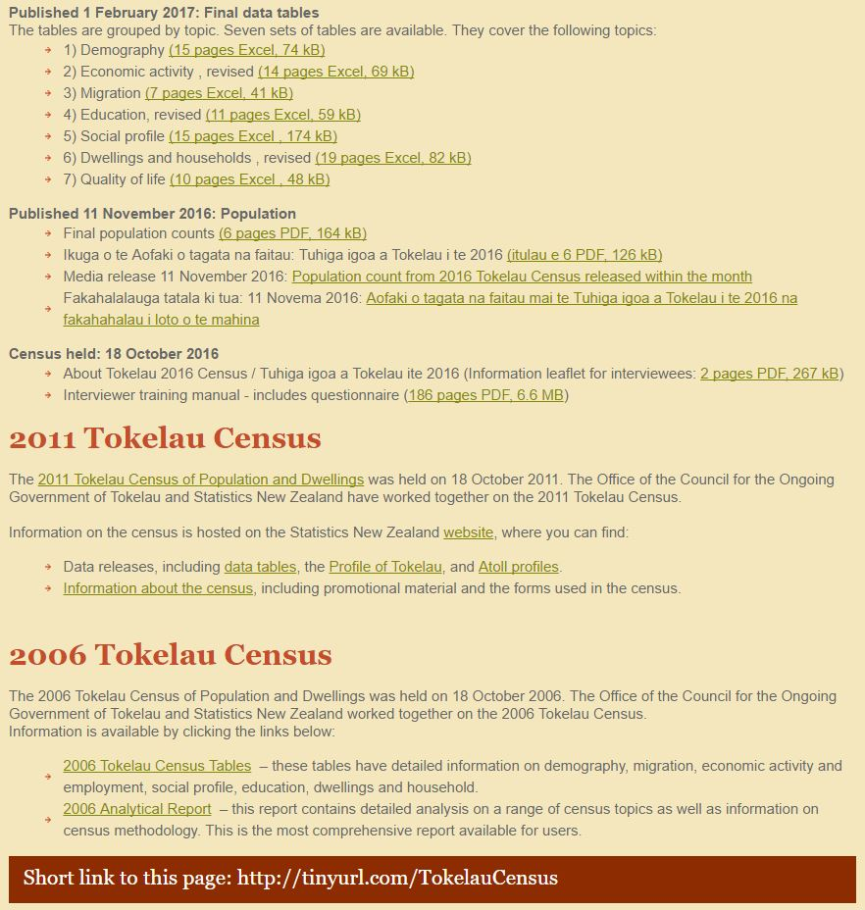

Slide 35
Notes:
You can access the information from the 2016 Census via the Stats NZ website – each link will take you through to the relevant page on the Tokelau website (show next slide).

